Slide 1
Fig. 1
https://www.bepanthen.co.uk/en/understanding-your-skin/your-skins-structure/
https://www.bepanthen.co.uk/en/understanding-your-skin/your-skins-structure/
Notes:
Skin cream effects the skins surface! The stratum corneum! Not collagen/elastin fibers
→ The biological effects of the cosmeceutical effects of skin cream on collagen fibers is not part of this work
→ Cosmeceuticals: pharmaceuticals and cosmetics – not well developed; A LOT of missing scientific information…

Slide 2
Table 1 Existing testing Methods
[11, 14-17]

Slide 3
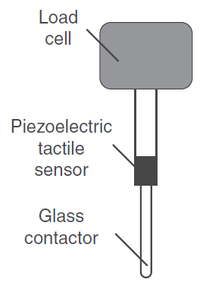
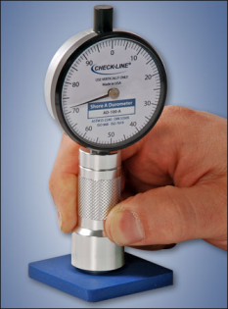
Fig. 2 Existing testing Methods
a) Cutometer
b) piezoelectric sensors
a
Skin indenter
c
Basic principle of
skin indenters
c) Durometers
d: skin corneometer
b
corneometers
a and b: skin indenters
Notes:
Cutometer - elasticity
piezoelectric sensors – mechanical properties
Durometers - hardness
Corneometers – water content
No surface properties – friction (adhesion), roughness/smoothness
There’s also Atomic Force Microscopy AFM – not practical, more nano scale, samples are so small
https://www.courage-khazaka.de/index.php/en/products/scientific/134-skin-glossymeter

Slide 4
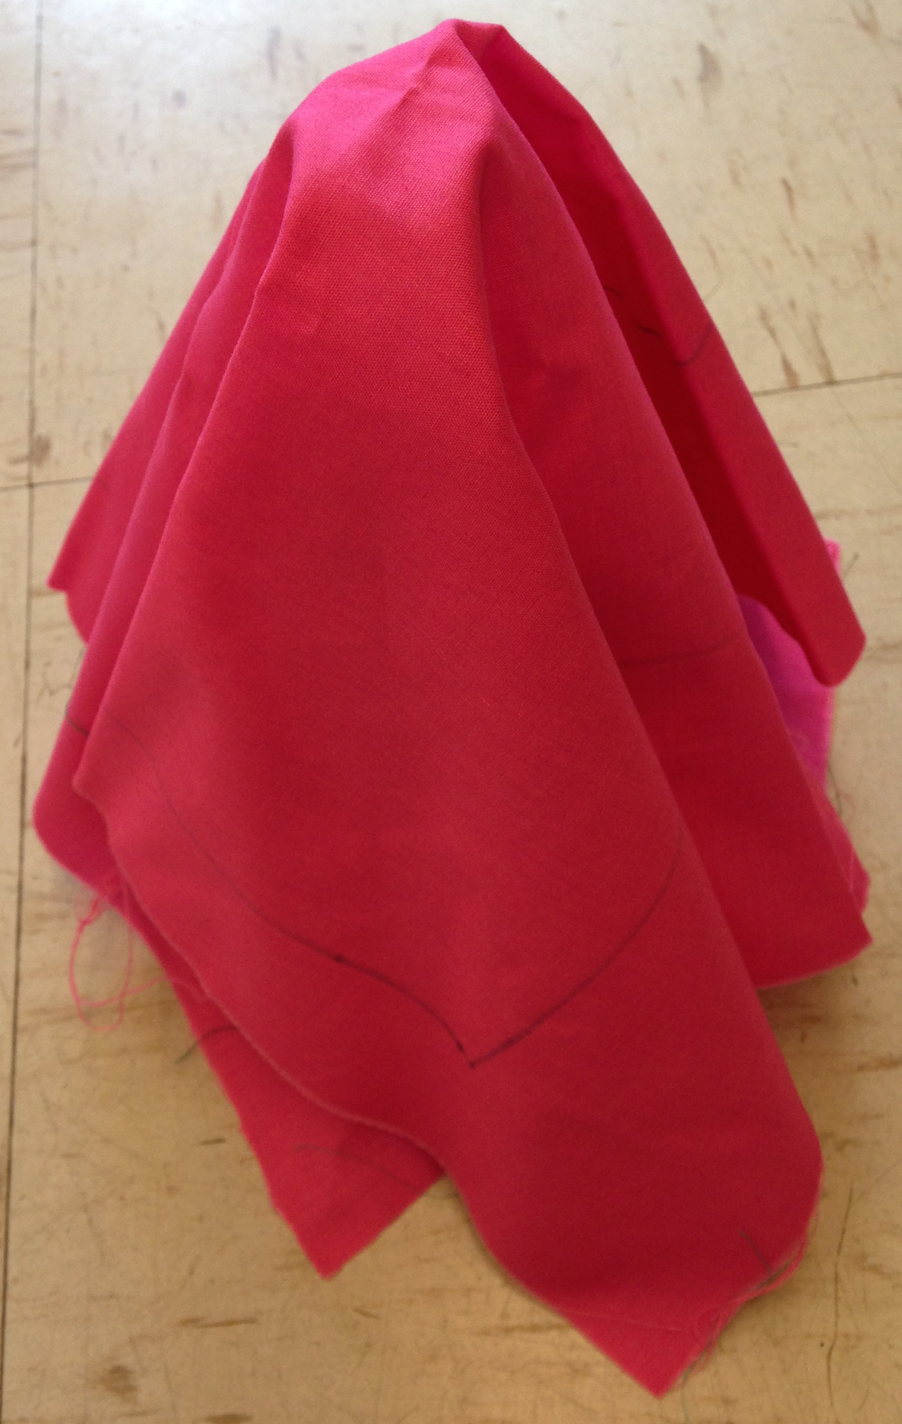
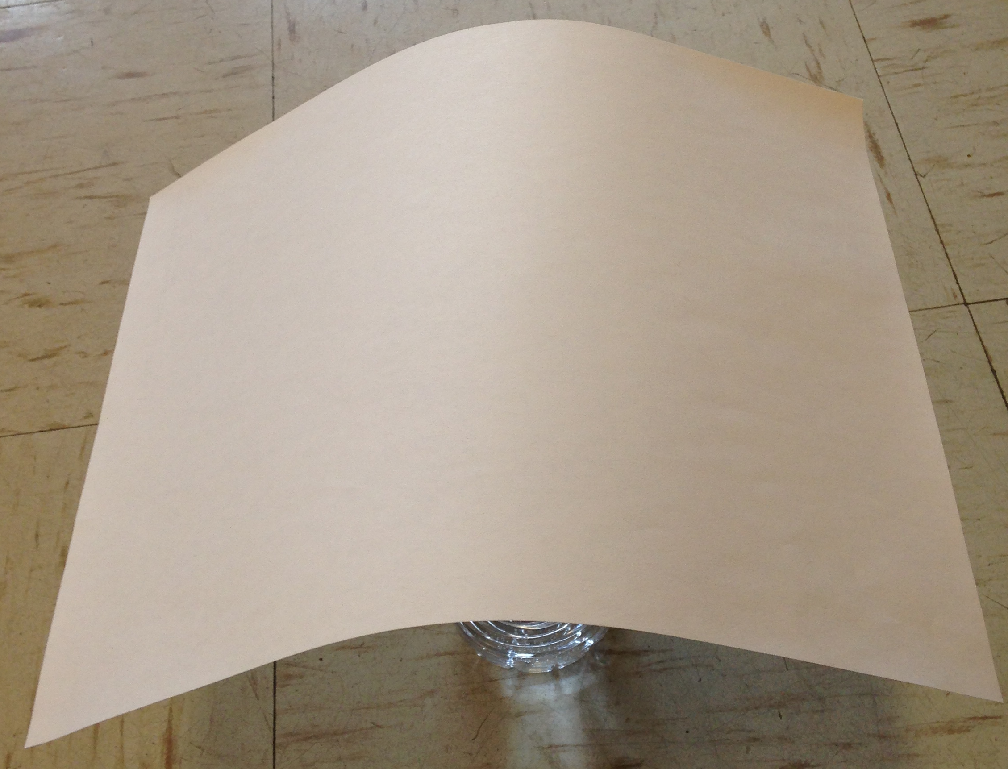
Fig. 3 Draping of a fabric and paper
a) A fabric wrinkles
b) A paper sheet can only bend

Slide 5
Table 2 Different testing methods and challenges
 | Existing methods | PhabrOmeter
Issues Subjective and random bias Complex deformation Connecting to sense Skin properties Elasticity Surface friction Moisture content | X Y X Y X Y | Y Y Y Y Y X
X: unable to dealt with.
Y: able to dealt with.

Slide 6
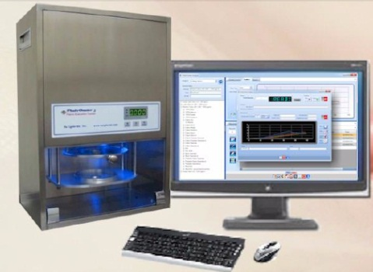
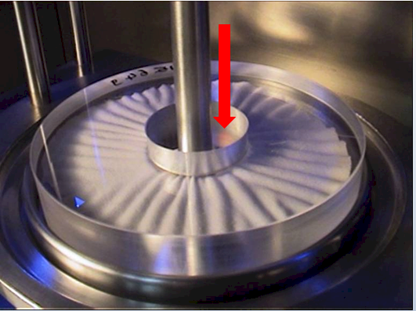
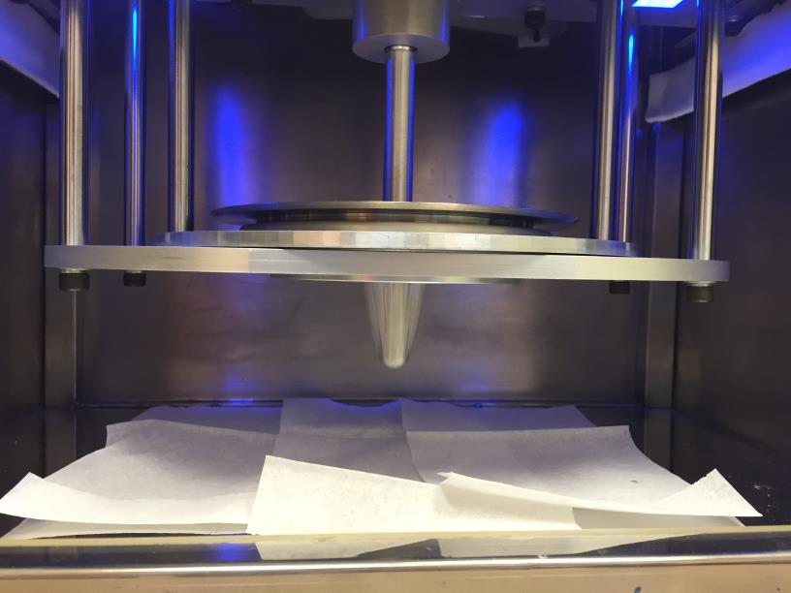
Fig. 4 A Vitro-skin sample tested on PhabrOmeter
a
b
c

Slide 7
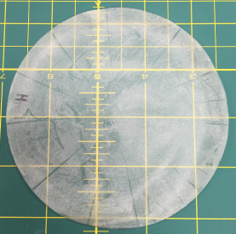

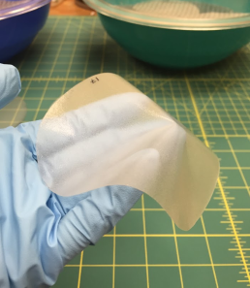
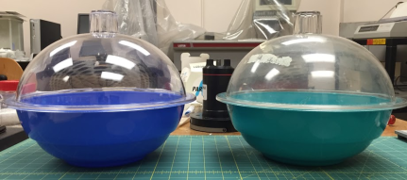
Fig. 5 Vitro-skin sample and hydration treatment
a
b
c
d

Slide 8
Table 3a The specs of the creams used
Product Name | Manufacturer | Unit Price /fl.oz | Notes
Badger Aloe Vera Gel Unscented | Badger | $1.25 *
Luminesce Daily Moisturizing Complex | Jeunesse Global | $47.00 *
Bio-Performance Advanced Super Restoring Cream | Shiseido Company | $50.80 *
* The prices are all from Amazon.

Slide 9
Table 3b The repeatability of the tests
Tested Curve Properties ( within group CV values%, 3 repeat each)
Name | Peak | Slope | Area
Original | 3.12 | 3.37 | 1.97
Aloe vera | 2.05 | 4.45 | 2.51
Luminesce | 3.18 | 2.88 | 3.52
Shiseido | 0.75 | 0.8 | 1.7
All the data are in relative terms for now.

Slide 10
Fig. 6a Analysis of a single extraction curve
Load (kg)
P
A
S
Time t (s)

Slide 11
Fig. 6b the repeatability of the tests
Time t (s)

Slide 12
Fig. 6c Sensitivity test by PhabrOmeter
Time t (s)

Slide 13
Fig. 7a The effect of cream Aloe vera
Time t (s)

Slide 14
Fig. 7b The effect of cream Luminesce
Time t (s)

Slide 15
Fig. 7c The effect of cream Shiseido
Time t (s)

Slide 16
Fig. 8 Overall comparison
(a)
(b)

Slide 17
Fig. 8 Overall comparison
(c)
(d)

