Slide 1
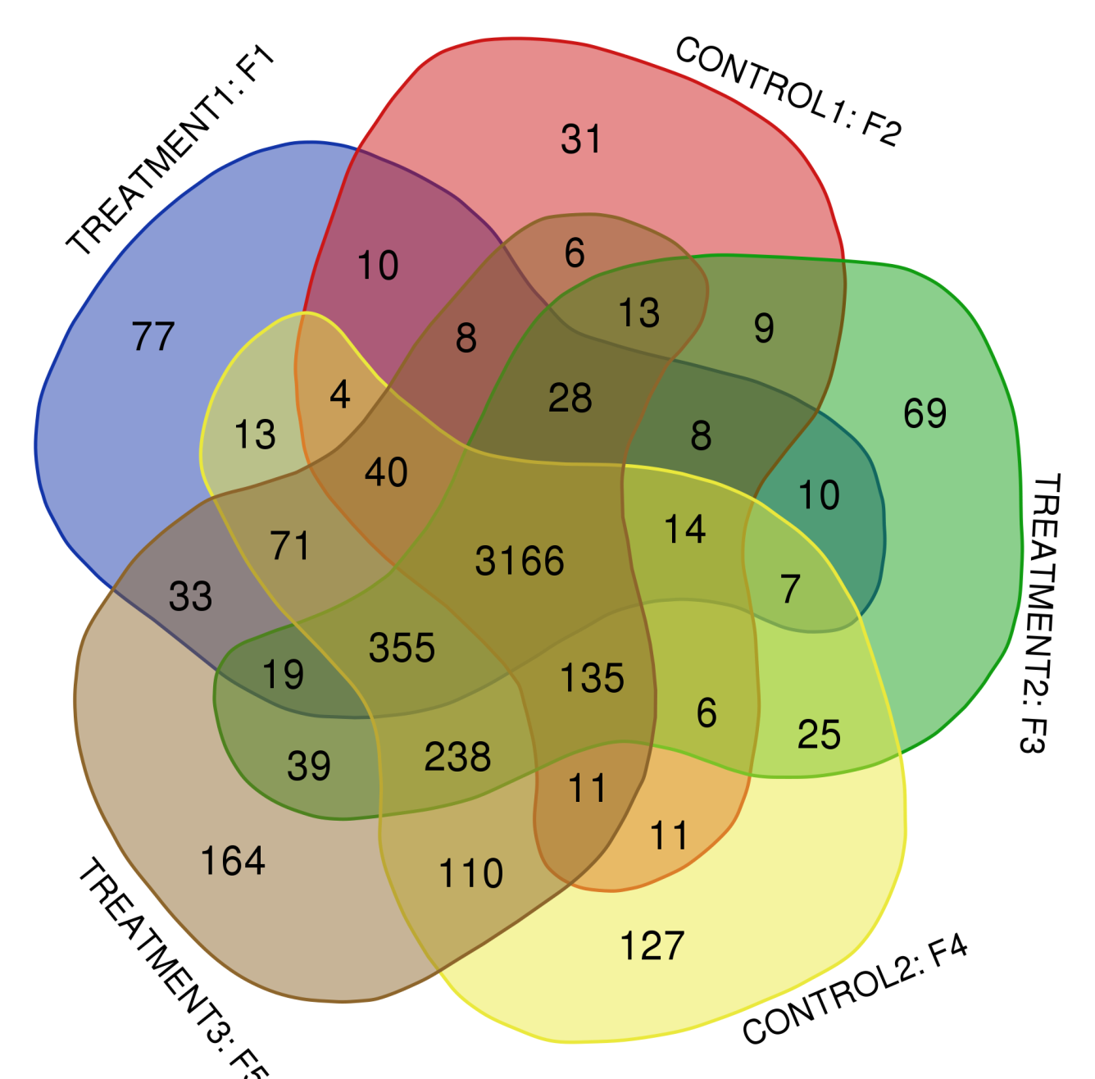
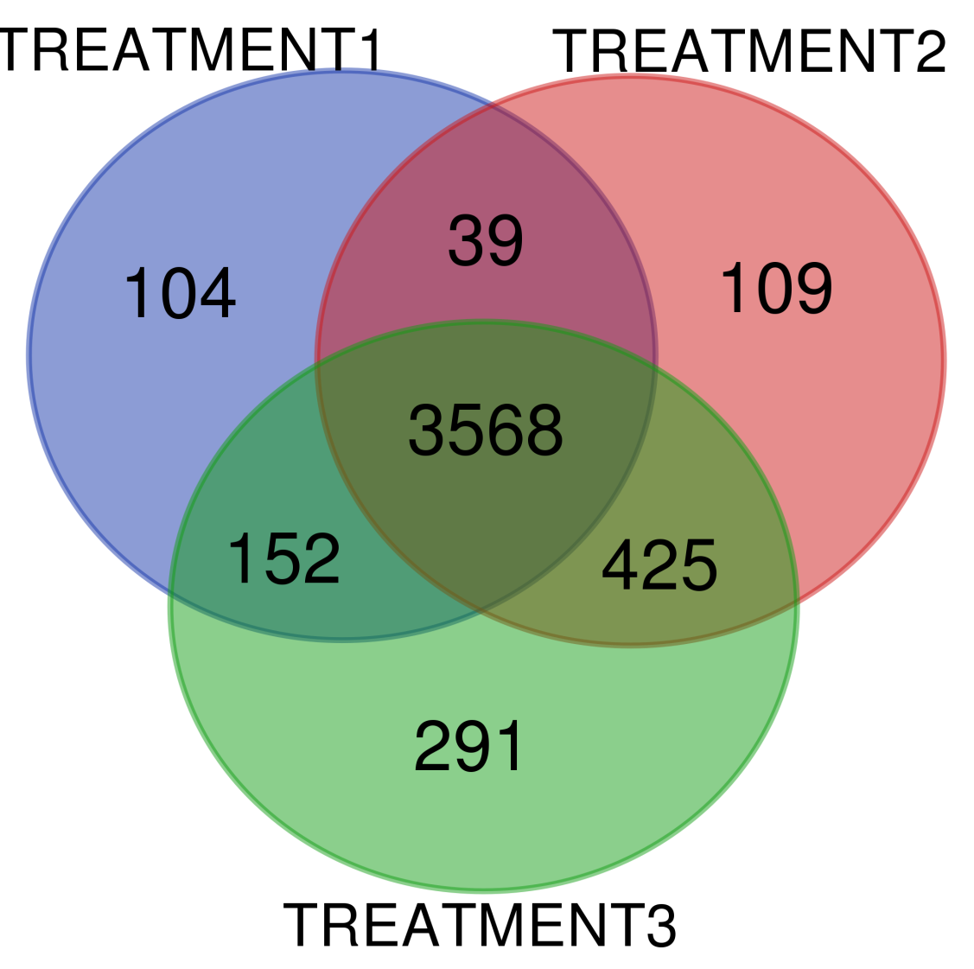
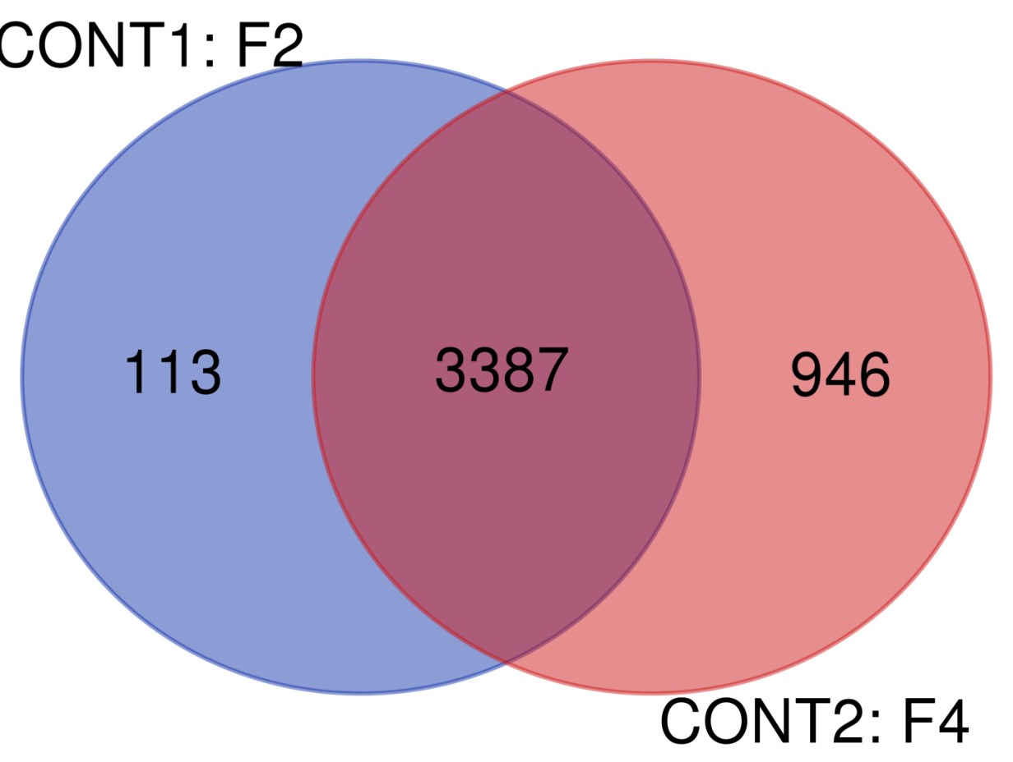
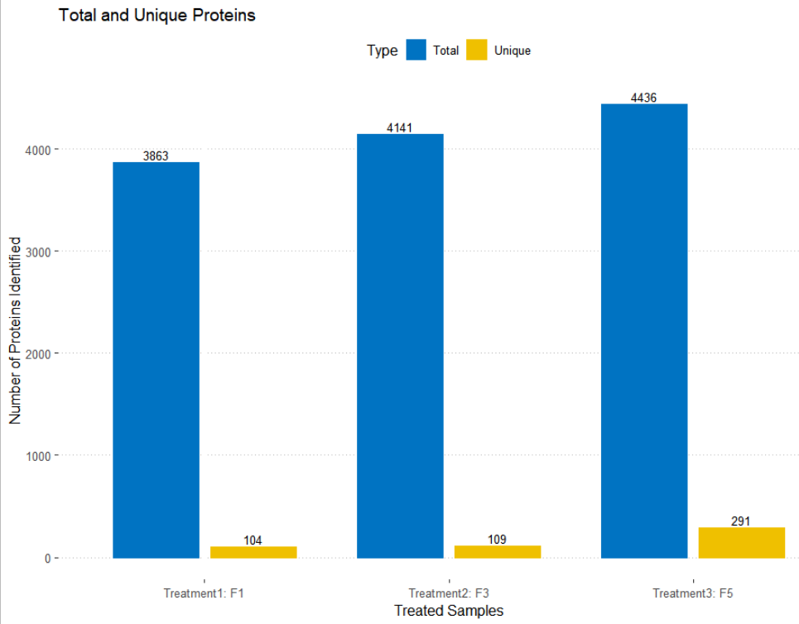
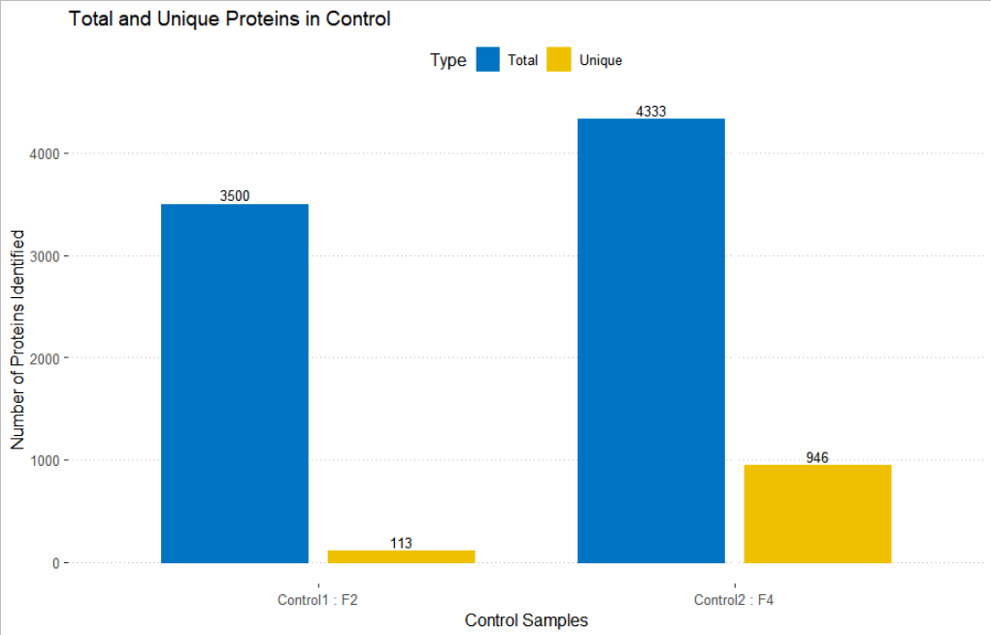
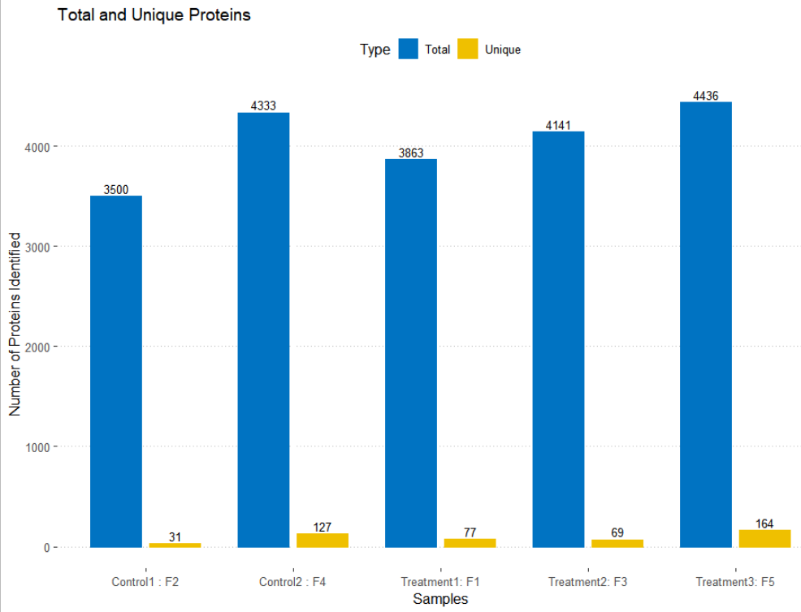
Fig S1.
C
A
B
Venn diagram- Total Samples
Venn diagram- Treatment Group
Venn diagram- Control Group
D
E
F
Protein identification in treatments
-Comparison Plot
Protein identification in control
-Comparison Plot
Protein identification-Comparison Plot

Slide 2
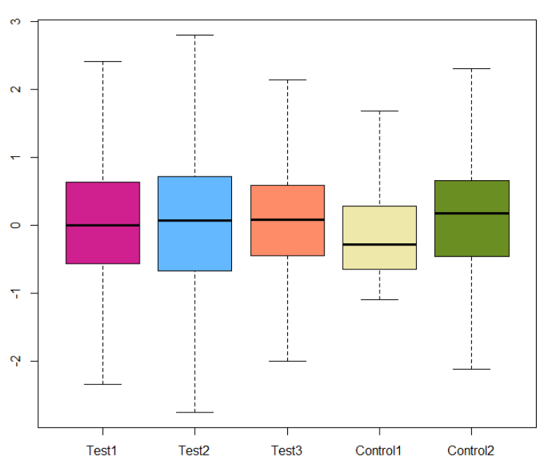
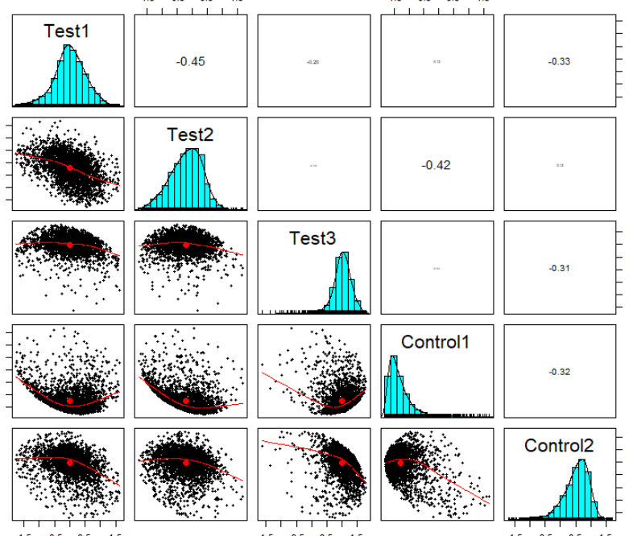
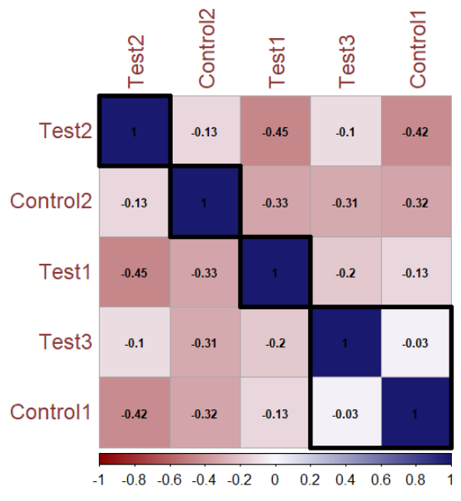
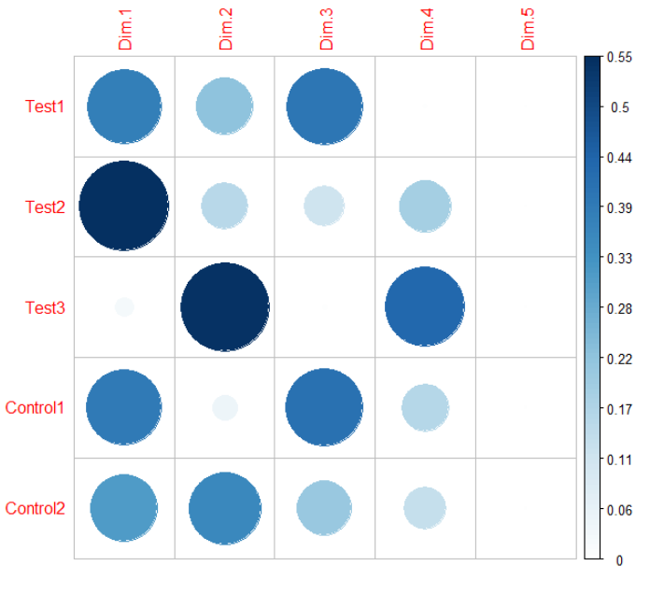
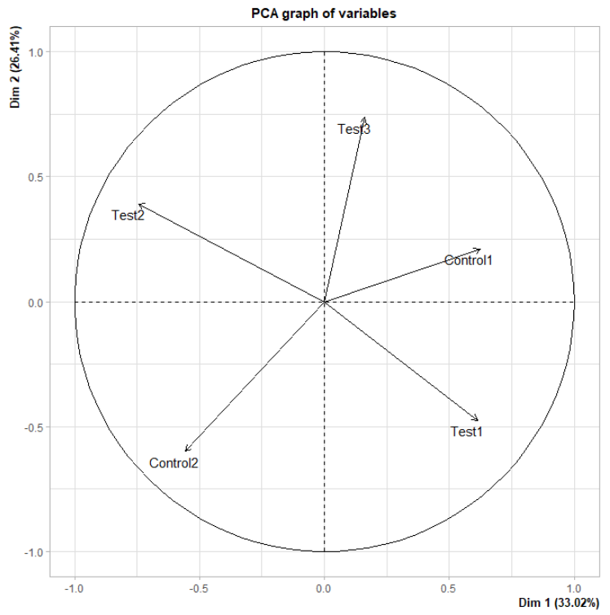
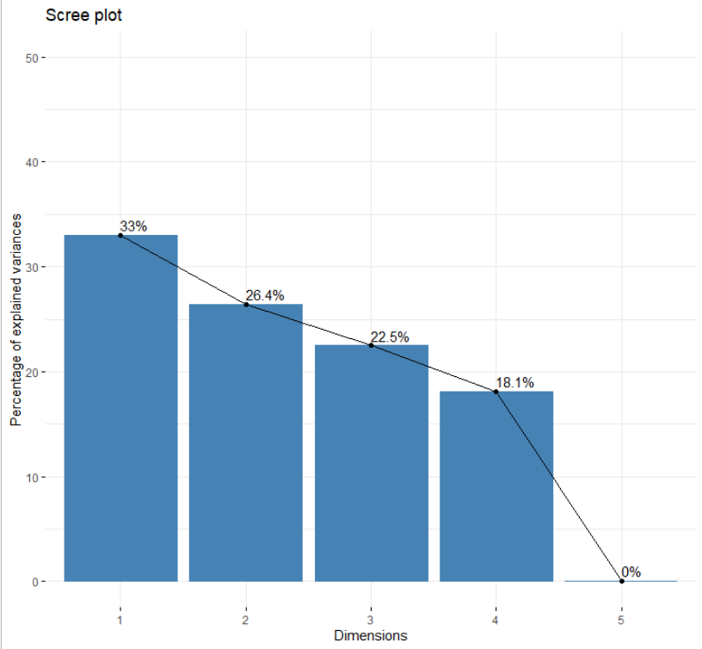
Fig S2.
A
B
C
SAMPLE ABUNDANCE- NORMALIZED
CORRELATION PLOT
CORRELATION PLOT
E
F
D
SCREEPLOT: PC VS VARIANCE PLOT
PC - CORRELATION PLOT
PCA - BIPLOT

Slide 3
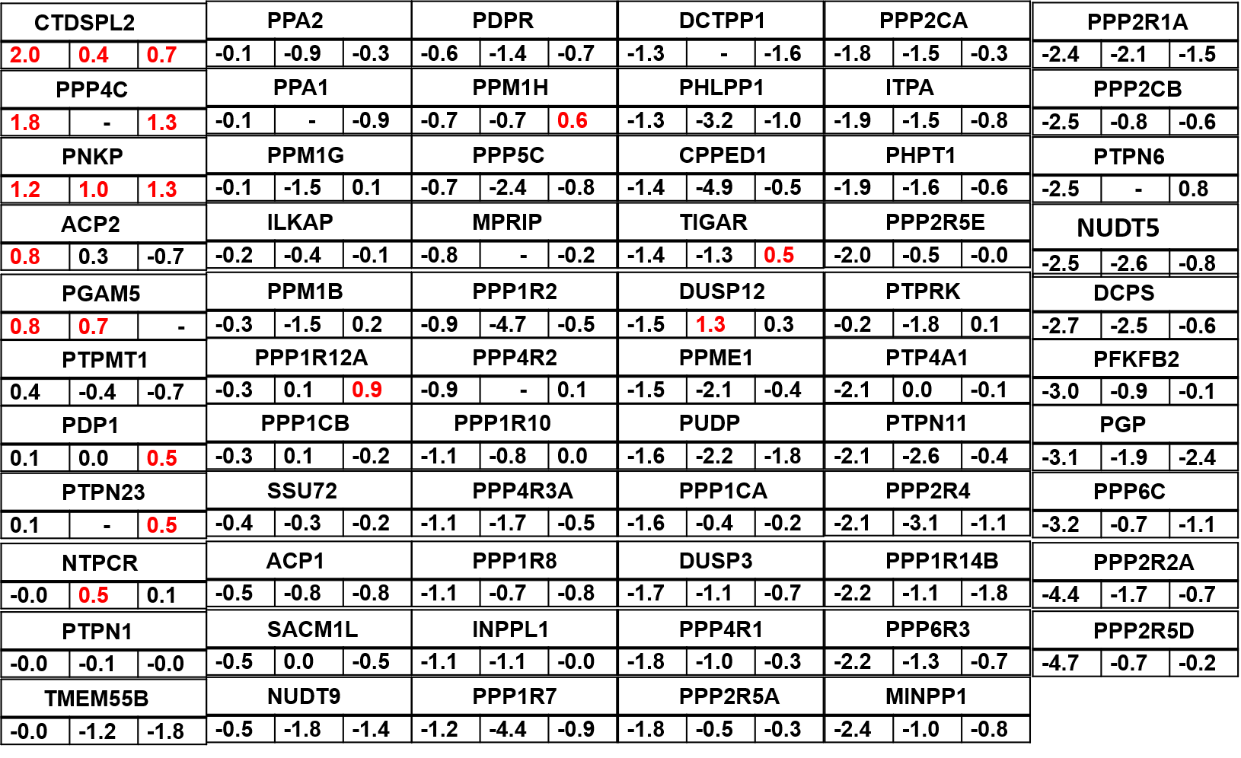
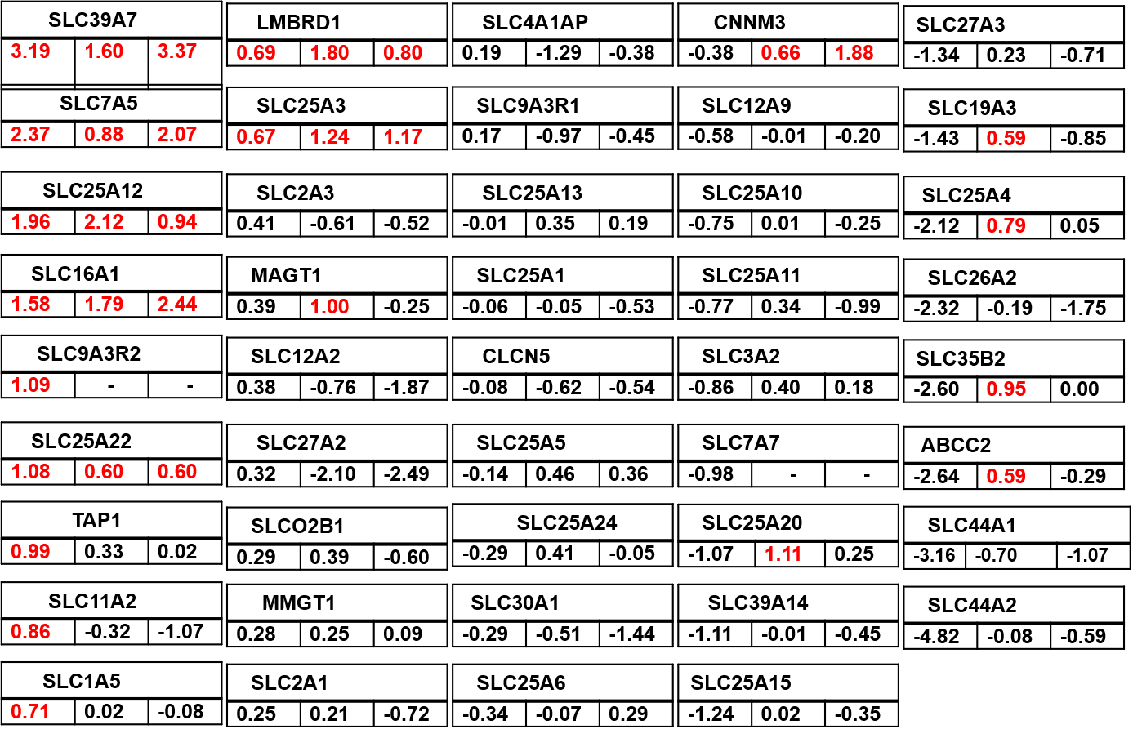
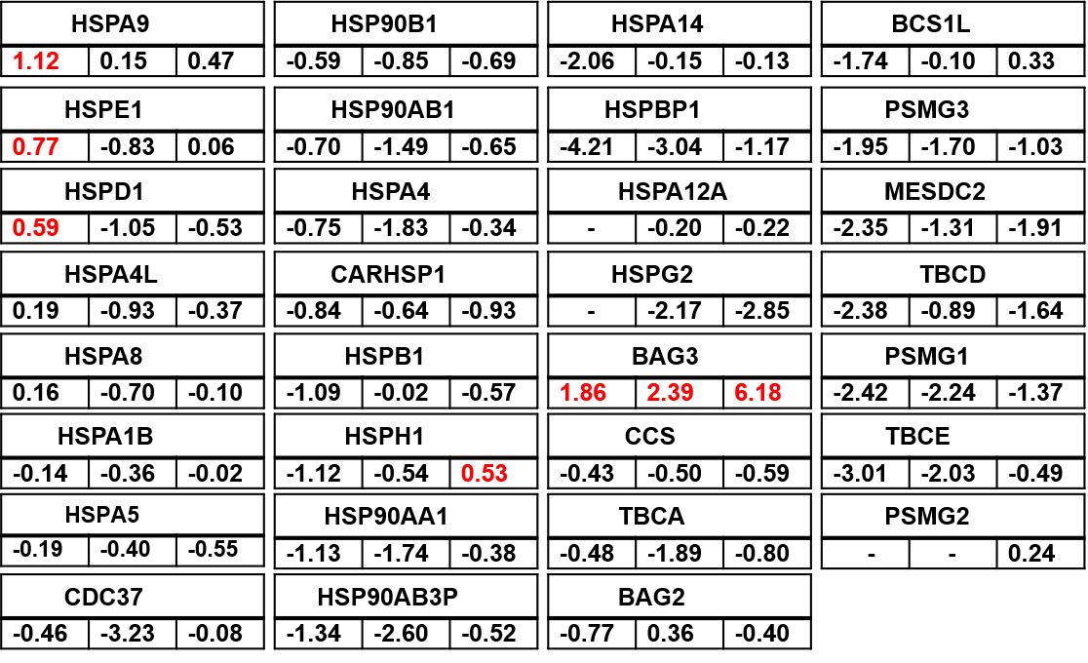
Fig S3.
A
B
C
D

Slide 4
Fig S4.
HIST1H2AB
4.3 | 2.1 | 0.9
H1F0
2.2 | 1.6 | 0.8
PHF8
1.3 | 0.9 | 0.2
HIST1H3A
0.9 | 1.1 | 0.0
KDM1A
-0.4 | -2.3 | -0.3
HAT1
-1.7 | -0.5 | -0.8
HMGN2
3.7 | 1.3 | 2.9
HIST1H2BD
2.1 | 3.2 | -0.1
HIST3H2BB
1.3 | -0.0 | 0.6
HIST1H2BK
0.8 | 0.7 | 0.0
HDAC2
-0.5 | -0.4 | -0.3
HPF1
-2.8 | 2.0 | 0.0
SAP130
3.4 | 0.6 | 3.0
HIST1H1D
1.9 | 1.4 | 0.9
HMGN1
1.2 | 1.4 | 2.2
CARM1
0.7 | -0.7 | -0.6
HIST2H3A
-0.6 | -0.5 | -0.4
ASH2L
-3.5 | -1.0 | 1.9
KAT7
3.2 | 0.4 | 2.1
H2AFX
1.6 | 3.0 | 0.7
HDAC1
1.2 | -0.2 | -0.9
H2AFY
0.4 | 0.8 | 0.1
RBBP4
-0.7 | -1.6 | -0.0
SAP30
- | 2.7 | 1.7
SAP18
2.8 | 2.2 | 1.4
H1FX
1.5 | 1.1 | 0.5
HIST1H2BJ
1.0 | 1.2 | 0.6
HIST1H4A
0.3 | 0.7 | -0.1
RBBP7
-1.0 | -0.9 | -0.2
SETD3
- | 0.8 | -
HIST2H2AB
2.3 | 1.7 | 1.0
HIST1H1B
1.4 | 0.8 | 0.7
H2AFZ
1.0 | 1.9 | 0.1
HIST2H2AC
0.2 | 1.0 | 0.6
H3F3A
-1.5 | 0.6 | -2.5
NSD1
- | -0.4 | -1.8

