Slide 1
Fig. 1
A
Mock
4T1
4T1+CP
B
Mock
4T1
4T1+CP
C
Mock
VEGF
bFGF
Amiloride
CP2.5
CP10

Slide 2
Fig. 2
A
Mock
bFGF
bFGF+CP2.5
bFGF+CP5
B
Content of Hb (mg/ml)
100
*
*
*
75
50
25
0
Mock
bFGF
bFGF+CP2.5
bFGF+CP5
C
Mock
bFGF
bFGF+CP2.5
bFGF+CP5

Slide 3
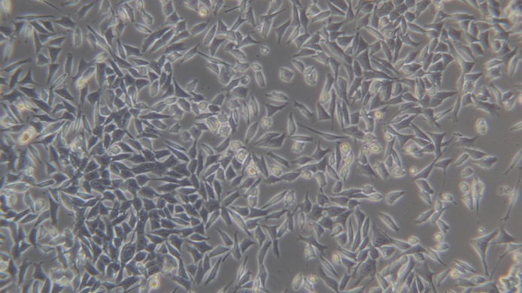
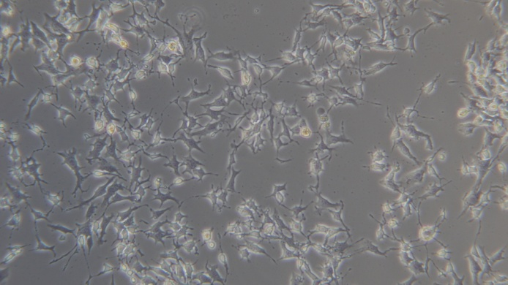
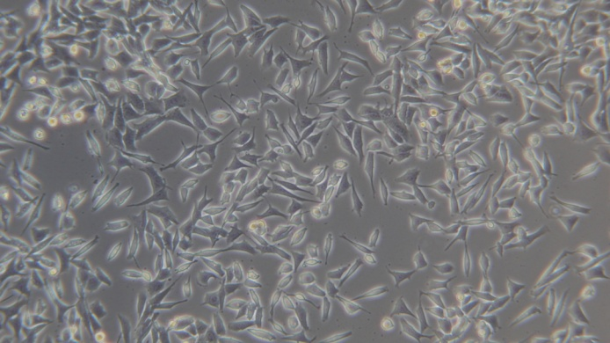
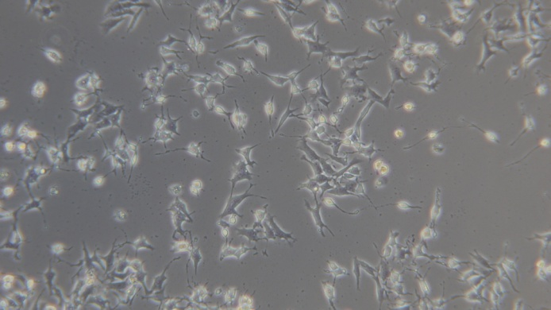
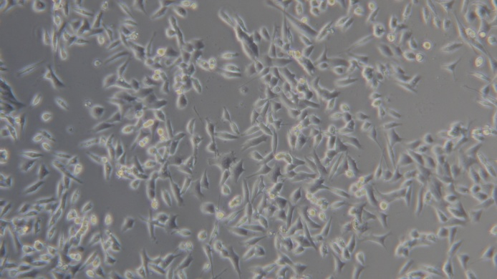
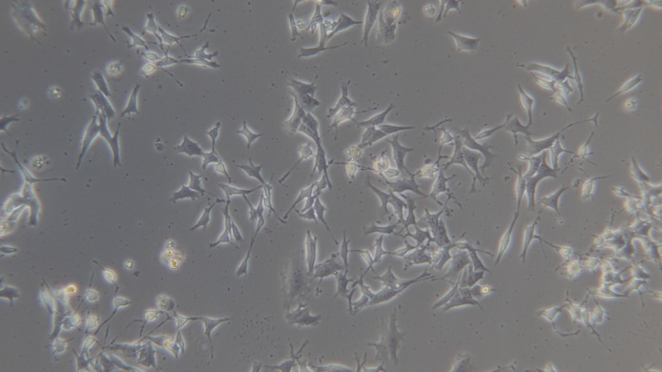
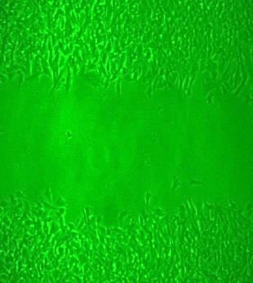
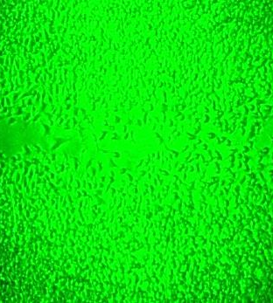
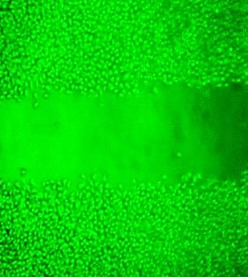
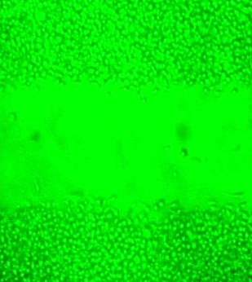
Fig. 3
A
B
Mock
CP 24 h
CP 48 h
Normoxia
Hypoxia
Mock
Mock
C
*
CP1
CP1
Cell viability (%)
*
*
100
80
60
40
CP5
CP5
20
0
-
+
-
CP1
-
-
+
CP5
D
Normoxia
Hypoxia
Mock
CP5
Mock
CP5
PKCα
β-actin
PKCα/β-actin
1
1.16
2.96
2.14
E
Starvation
FBS
FBS+CP1
FBS+CP2.5
FBS+CP5

Slide 4
Fig. 3
F
Normoxia
Hypoxia
Mock
CP1
CP5
Mock
CP1
CP5
VEGF
Hypoxia: CoCl₂ 200 μM
Treatment: 6 h
GAPDH
VEGF/GAPDH
1
1.15
1.26
1.44
1.27
1.10

Slide 5
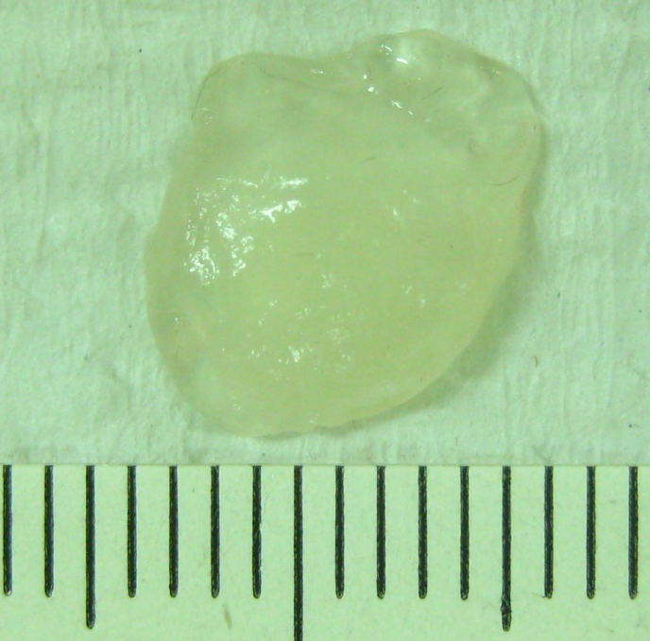
Fig. 4
A
CP5
CP2.5
Mock
12 h
24 h
48 h
12 h
24 h
48 h
PDIA4
1
0.66
0.38
0.27
0.44
0.23
0.35
β-actin
1
0.92
1.31
0.91
1.41
1.38
1.13
PDI4/β-actin
1
0.72
0.29
0.30
0.31
0.17
0.31
B
VEGF
Mock
C57BL/6
PDIA4 KO
C
Content of Hb (mg/ml)
*
25
*
*
20
15
10
5
0
Mock
C57BL/6
PDIA4 KO
VEGF

