Slide 1
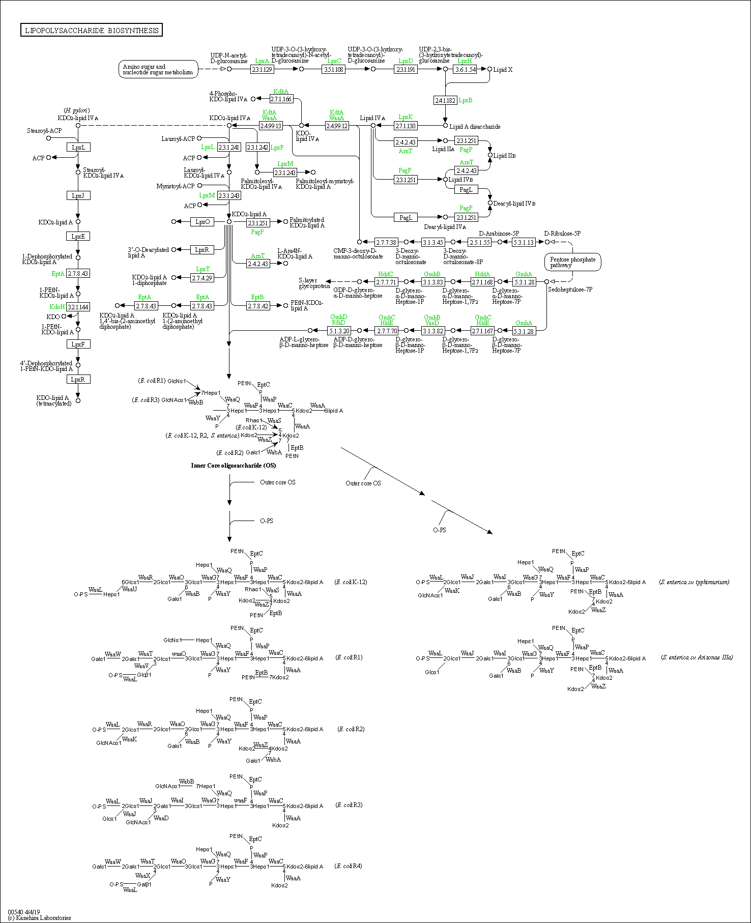
Figure S1
K03270:
3-deoxy-D-manno-octulosonate 8-phosphate phosphatase (KDO 8-P phosphatase
K06041:
arabinose-5-phosphate isomerase
K02535:
UDP-3-O-[3-hydroxymyristoyl] N-acetylglucosamine deacetylase
K02536:
UDP-3-O-[3-hydroxymyristoyl] glucosamine N-acyltransferase
K00979:
3-deoxy-manno-octulosonate cytidylyltransferase
K02527:
3-deoxy-D-manno-octulosonic-acid transferase
K01627:
2-dehydro-3-deoxyphosphooctonate aldolase
K02844:
UDP-glucose:(heptosyl) LPS alpha-1,3-glucosyltransferase
Functional orthologs are defined in the context of KEGG pathway maps and other molecular networks, which are created as networks of K number nodes (Kanehisa et al. 2014). The function of each gene is shown in the lipopolysaccharide biosynthesis pathway map.

