Slide 1
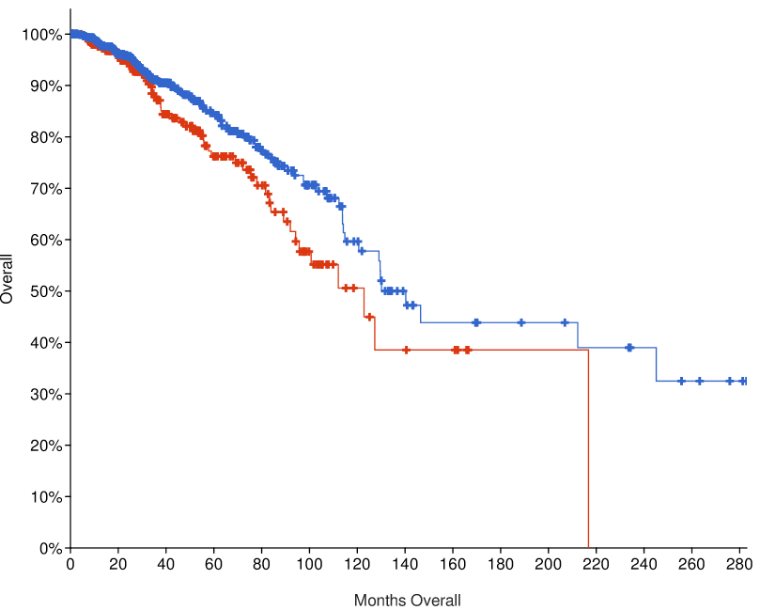
Figure 1
A
Overall Patient Survival
*
*
 | Number of Cases | Number of Deceased Patients | Median Months Survival
TGFβ High | 326 | 55 | 122.83
TGFβ Low | 754 | 96 | 140.28
Figure 1: Database Analysis of TGF-β Gene Expression and Survival in Breast Cancer Patients (A) Kaplan–Meier curves for overall survival of the patients with high expression of TGF-β signaling in cancer samples (red curve) in comparison with patients with unaltered expression (TGF-β low, blue curve). n = 1082, *P = 0.0303, log‐rank test.

