Slide 1

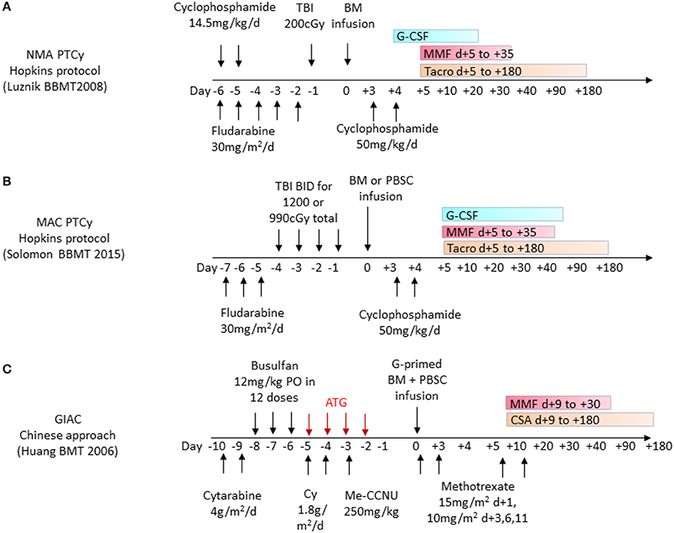


Figure S1.
A
Filgrastim
PBSCs
infusion
Tacro
3.2 mg/kg/d
MMF d+5 to +35
25 mg/m²/d
Myeloablating conditioning (MAC) regimen
B
Reduced intensity conditioning regimen
Figure S1. Study designs for haploidentical HSCT with PTCy.
With PBSC infusion on day 0 and PTCy on post-transplant days 3 and 4, patients received either the (A) myeloablating conditioning regimen (N = 19) or (B) reduced intensity conditioning regimen in the week prior to transplant.

Slide 2
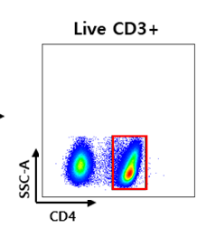
Figure S2.
Figure S2. Frequency of CD4+ T cells in LE vs non-LE patients.
(A) Flow cytometry gating strategy. (B) Statistical analysis before (BT) and on days 3, 5, and
21 post-HCST. Statistical difference by two tailed t-test.

Slide 3
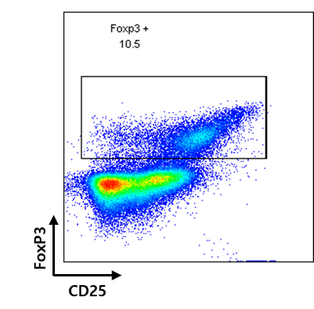
Figure S3.
A
B
C
BT
DAY5
DAY21
r = 0.635
p < 0.01
r = - 0.636
p < 0.01
r = - 0.389
p = 0.188
% of Foxp3+ in CD4+ cells
3
Figure S3. Frequency of CD4+Foxp3+ T cells in LE vs non-LE patients.
(A) Flow cytometry gating strategy. (B) Statistical analysis before (BT) and on days 3, 5, and 21 post-HCST. Statistical difference by unpaired two tailed t-test. *p < 0.05, **p < 0.01, ***p < 0.001. (C) Spearman correlation analysis with severity of acute GVHD at BT (left), post-HCST day 5 (mid), and post-HCST day 21 (right). The Spearman’s correlation coefficient (r) and p value were indicated.

Slide 4
Table S1.
Supplementary Table 1. Comparison of vasodilation and dyspnea between LE and non-LE patients
§ χ² test
Table S2.
Supplementary Table 2. Comparison of HLA types between LE and non-LE patients
§ χ² test

