Slide 1
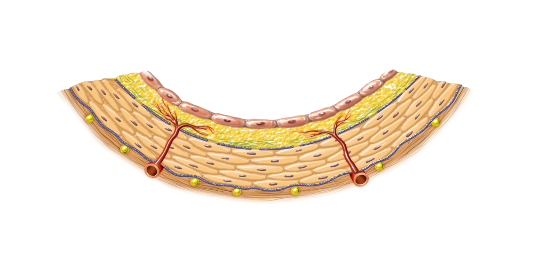
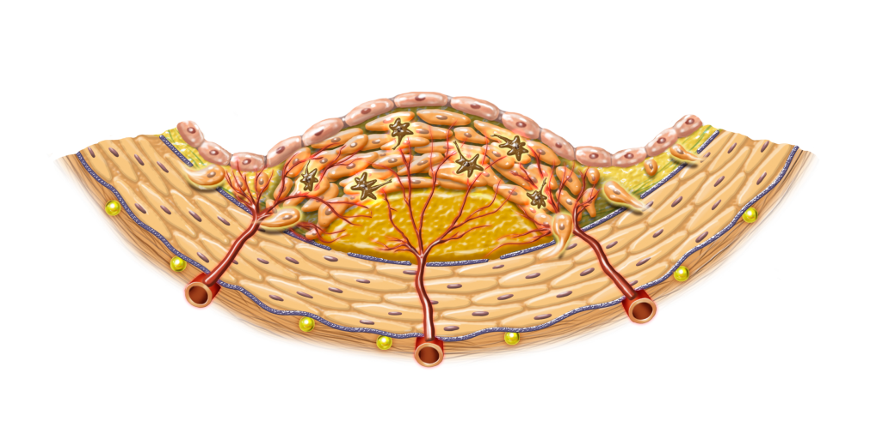
Fig1
Formation of Arteriosclerotic lesion ーStage Ⅰー
Normal
Arteriosclerotic lesion
Inflammatory Reaction
Smooth muscle cell proliferation
Macrophage infiltration
Intima
CAVI
Vasa vasorum
Media : smooth muscle cell
Adventitia
Lipid Pool
Choloesterol
Oxycholesterols
(Toxic)
Neovascularization
Oxidation
Shimizu＆Shirai , ISVH, 2021

Slide 2
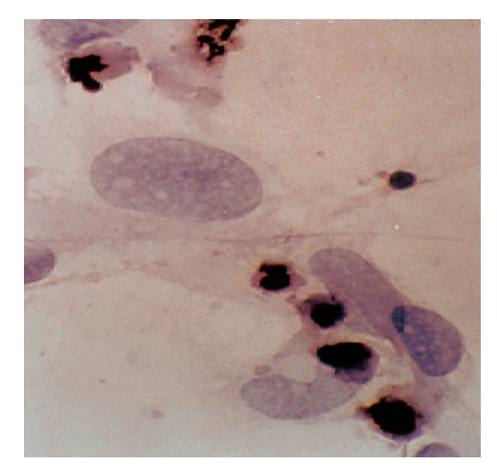
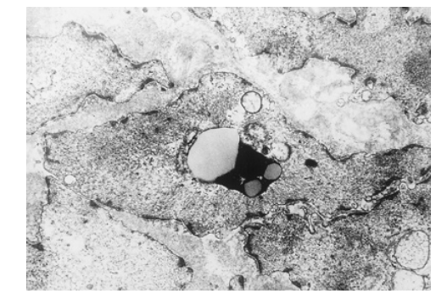
Fig２
A
B
Smooth muscle cell under Apoptosis of smooth muscle cell in human coronary atheromatous lesion (Electron microscope)
Cultured smooth muscle cell under apoptosis by adding oxysterol rich fraction

Slide 3
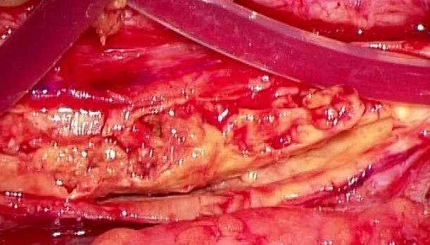
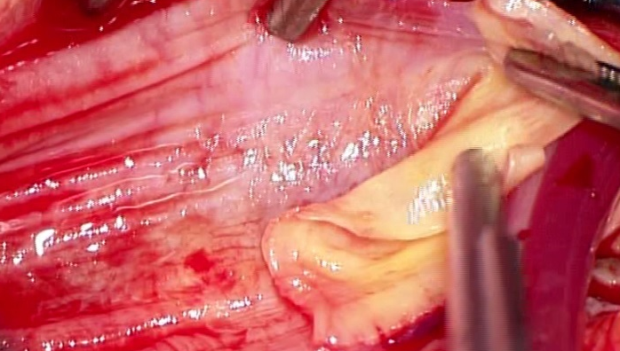
Carotid Endoarterectomy
Fig3 A
Thickened intimal arterioscletotic lesion
Peeled intimal lesion
Disclosed medial smooth muscle cell layer :
The blood oozes out on smooth muscle cell layer
Oozed blood was stopped with noradrenaline
Bleeding after peeling intimal atheromatous layer
Shimizu＆Shirai , ISVH, 2021

Slide 4
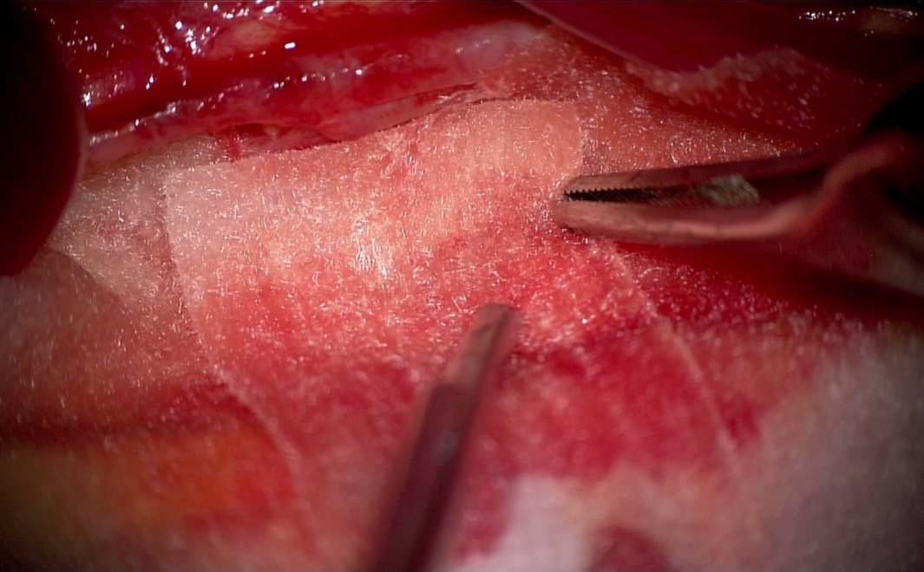
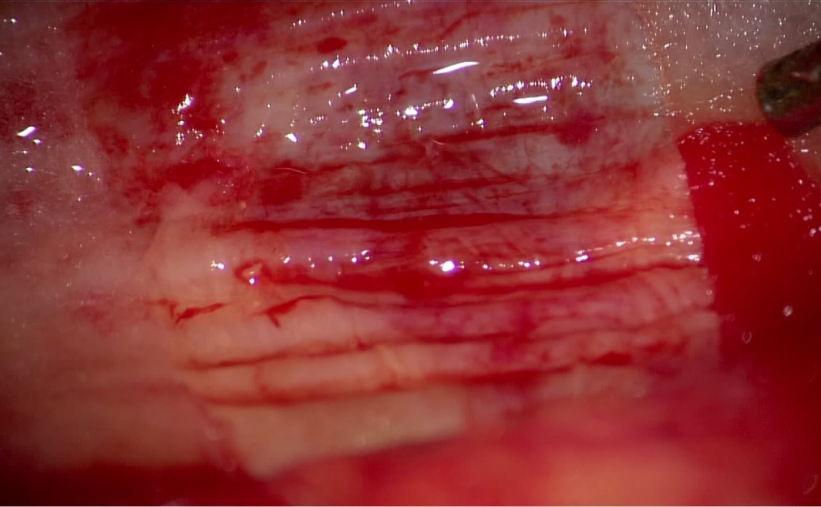
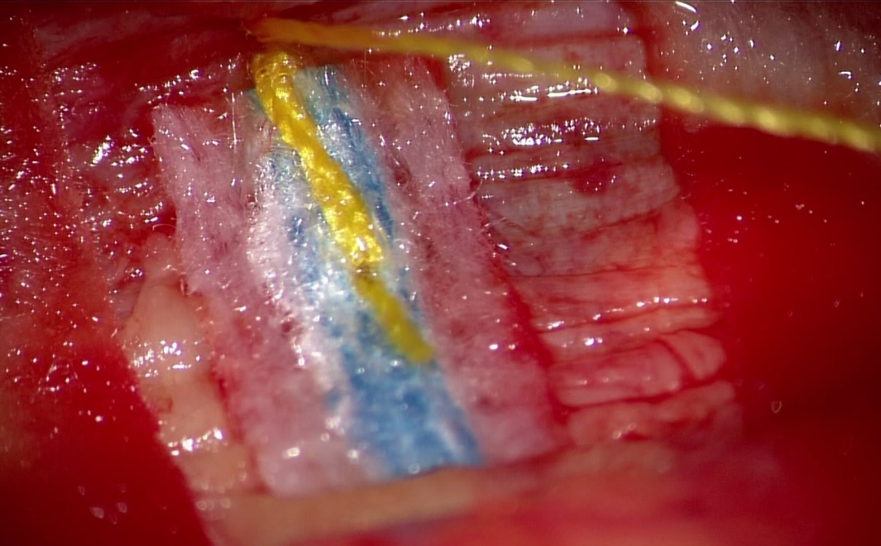
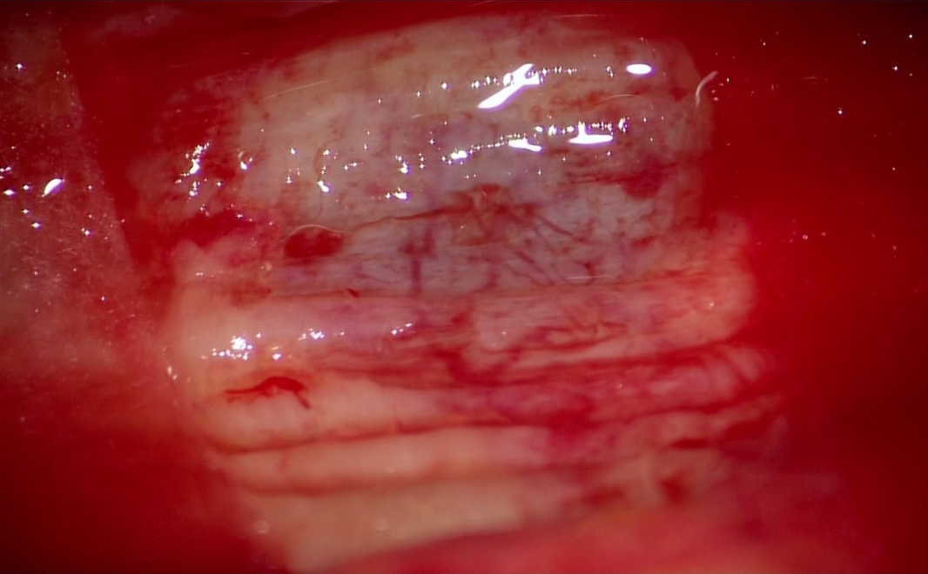
Fig3B
Effect of noradrenaline-dipped gauze on bleeding on the surface of
denuded medial smooth muscle cell layer at carotid endarterectomy
Bleeding +
Saline gause
Bleeding
Noradrenaline gauze
Shimizu＆Shirai , ISVH, 2021

Slide 5
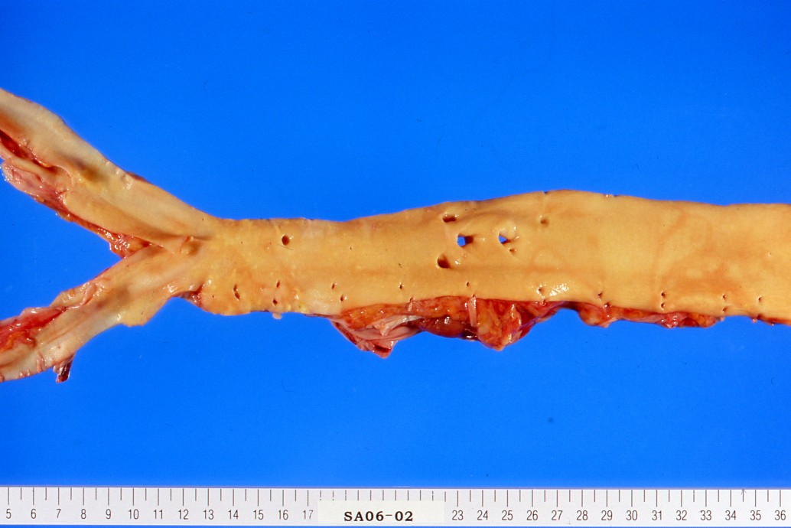
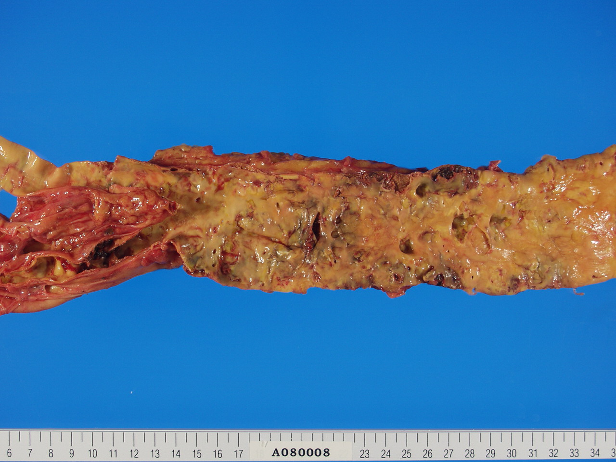
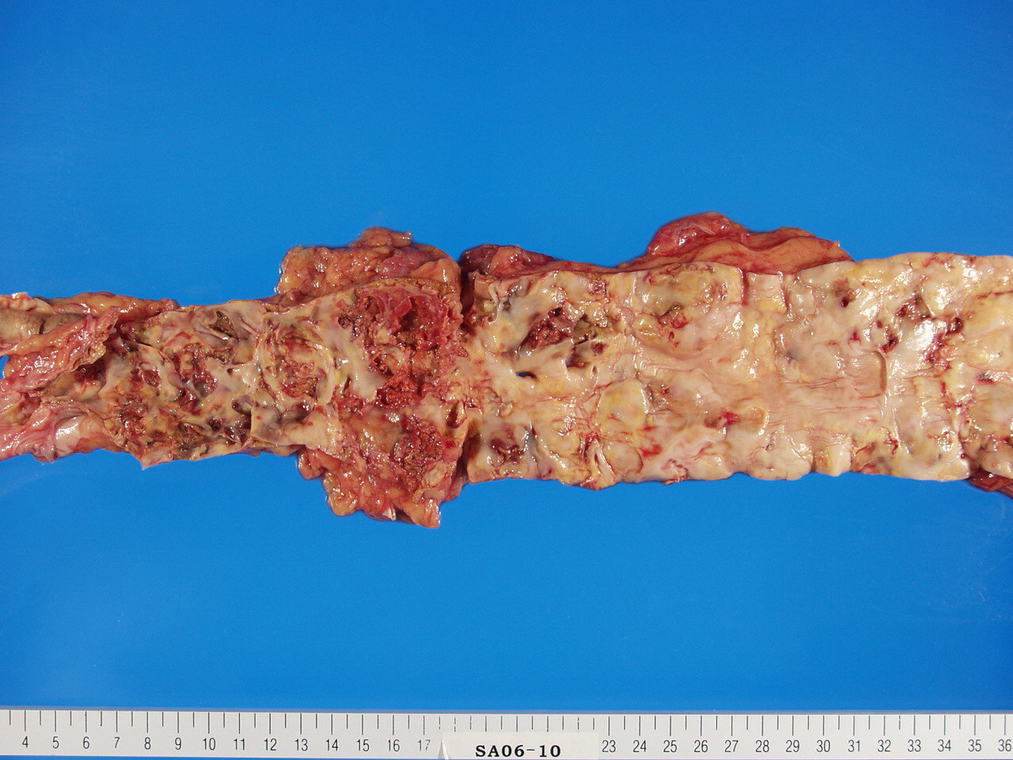
Fig 4
Shirai, 2011, JAT
A
50ys old woman
CAVI=7.3
A
B
74ys old man
76ys old man
CAVI=11.0
CAVI=11.0

Slide 6
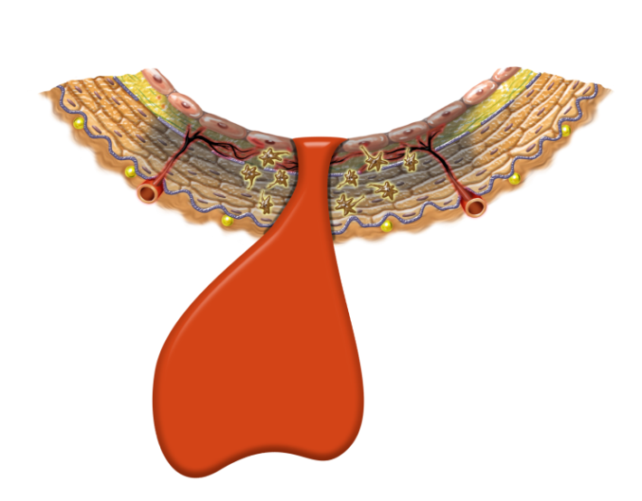
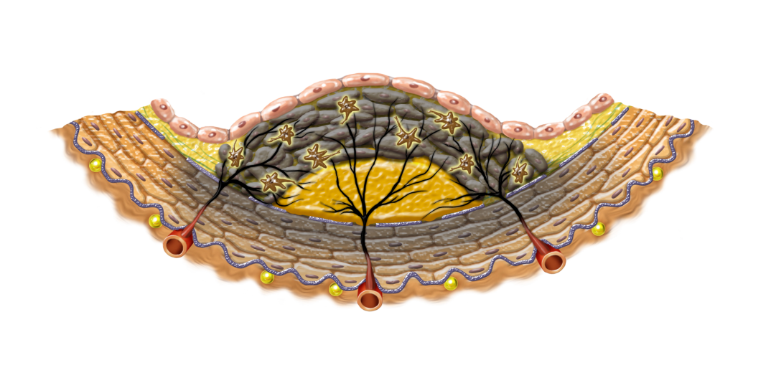
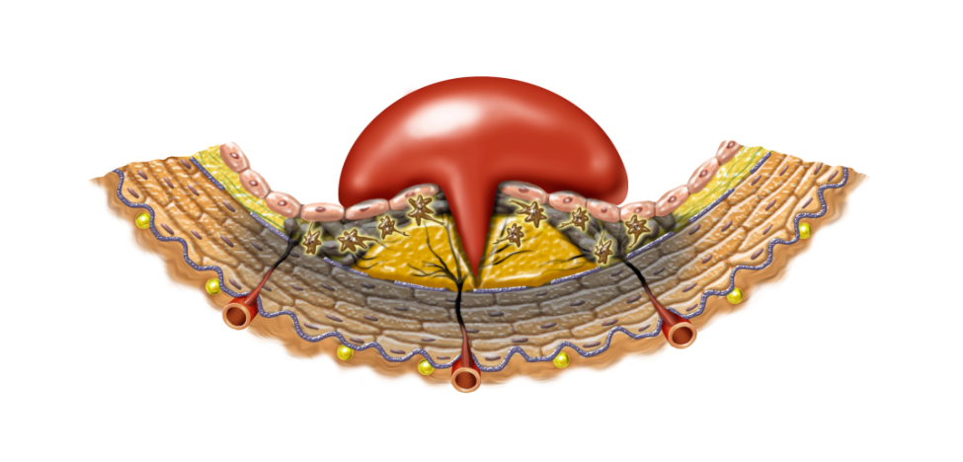
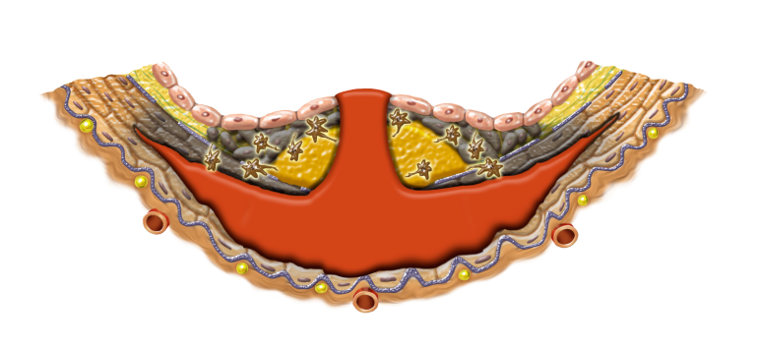
Fig5
Smooth muscle cell contraction and Plaque rupture ーStage Ⅱー
Medial smooth muscle cell contraction
Stragled vasa vasorum
Isｃhemia
Necrosis Plaque rupture
Vulnerable plaque
Hemorrhage
Myocardial infarction
Vasa vasorum
Strangled vasa vasorum
CAVI
Medial smooth muscle cell contraction =
ΔCAVI
Stress
Vasoconstrictive substances
Dissecting aneurysm
Shimizu＆Shirai , ISVH, 2021

Slide 7
Table 1
Treatments and Medicines for High CAVI
Life style change
Antihypertensives
Anti diabetic drugs
Lipid lowering agents
Weight reduction
Visceral fat reduction
ARB: Olmesartan
CCB: Cilnidipine
Efonidipine
Rapid-acting insulin
Pioglitazone
Glimepiride
Pitavastatin
Bezafibrate
Eicosapentaenoic acid
CPAP therapy for SAS
Exercise
Smoking cessation
Waon therapy
Supplyments
Resveratrol
s-Equal

