Slide 1
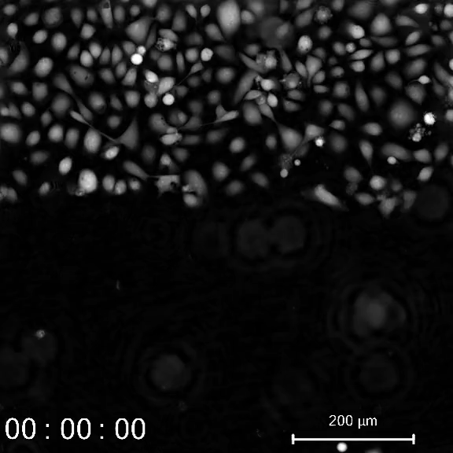
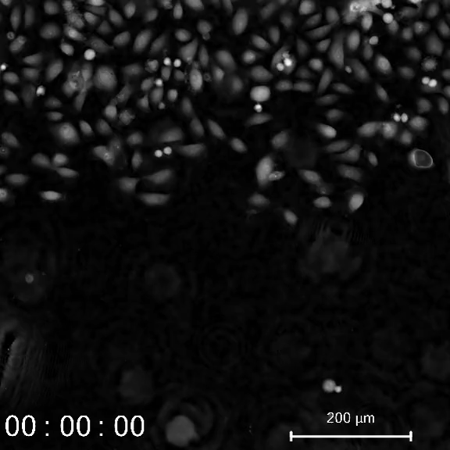
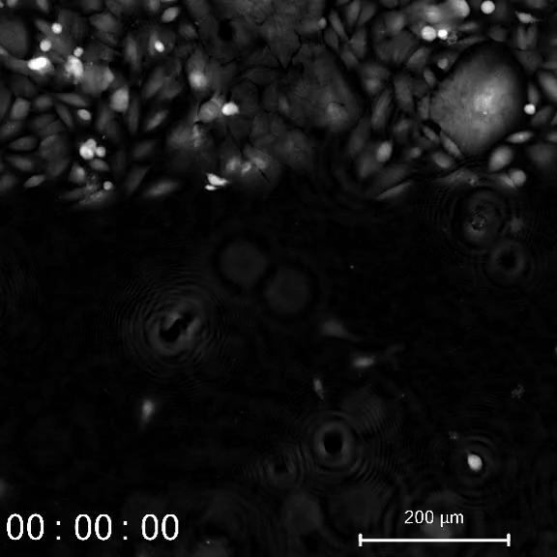
Extended Fig. 1 Non-malignant cells close the wound faster than cancer cells
HBEC30UI
HBEC30KT
HCC4017

