Slide 1
Supplementary

Slide 2
S1A
OCT4
NANOG
S1B
MAP2
NeuN
NeuroD1
BDNF
S1C
FOXA2
DAT

Slide 3
Supplementary figure 1: qPCR quality control of day 40 dopaminergic neurons (A) RT-qPCR analysis of relative mRNA expression of stem cell markers OCT4 and NANOG. (B) RT-qPCR analysis of relative mRNA expression of neuronal markers MAP2, NeuN, NeuroD1 and BDNF. (C) RT-qPCR analysis of relative mRNA expression of dopaminergic neuron-specific markers FOXA2 and DAT. (A-C) Data is represented as mean ± SD (n≥3). Data was analyzed by unpaired student’s t-test. Data was analyzed by unpaired student’s t-test. * p ≤ 0.05. ** p ≤ 0.01. *** p ≤ 0.001. **** p ≤ 0.0001.

Slide 4

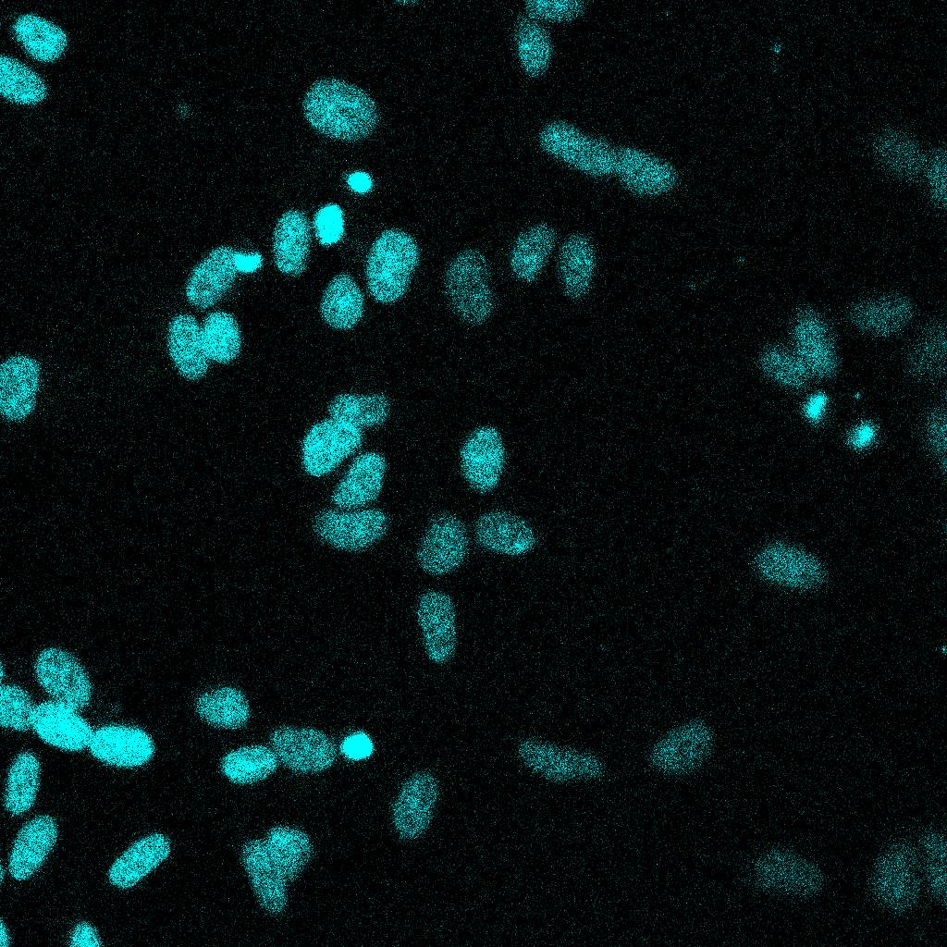
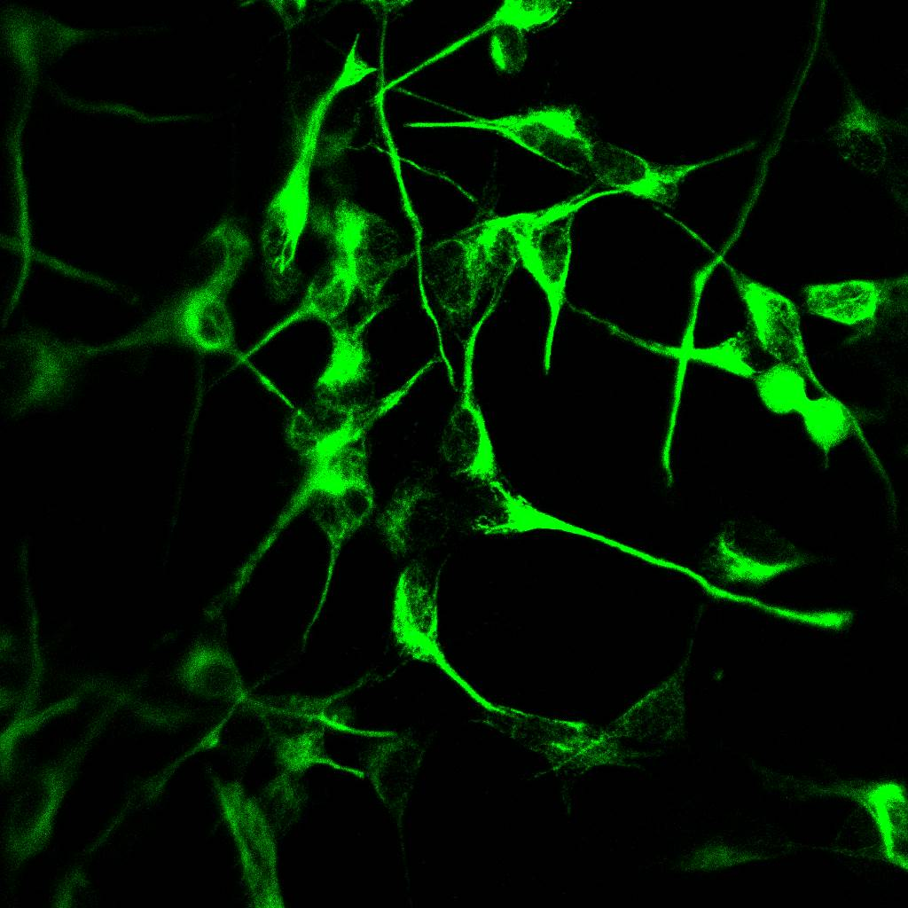
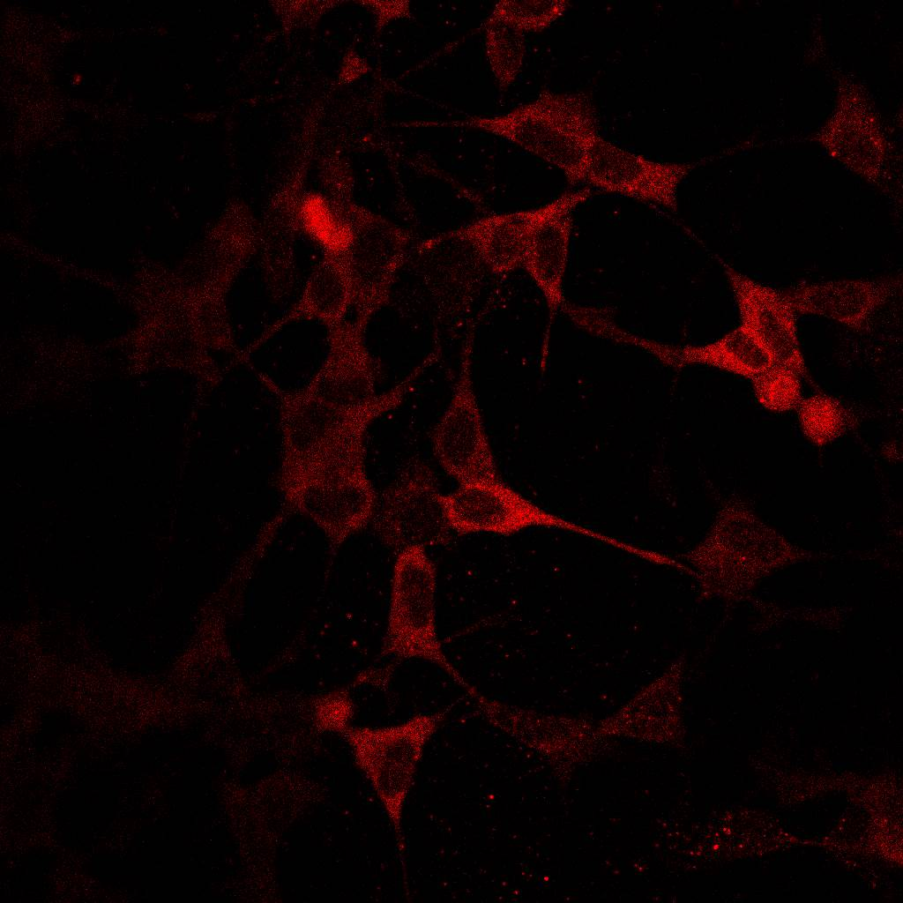
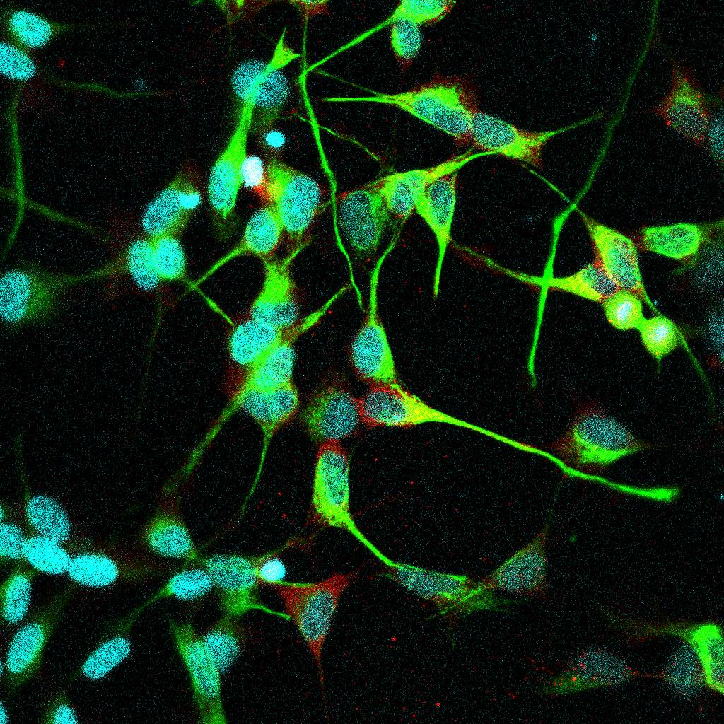
S2A
Cell viability assay
S2B
SH-SY5Y | D40 iDA + 6OHDA | D40 iDA
OCTN1
Caveolin
60kDa
22kDa
S2C
Cellular ET Uptake
S2D
Cellular ET Uptake
S2E
S2F
DAPI
Tyrosine Hydroxylase
Tyrosine Hydroxylase
DAPI
OCTN1
OCTN1
Merge
Merge

Slide 5
Supplementary figure 2: Expression of ET transporter, OCTN1, and intracellular uptake of ET protects TH+ cells. (A) Protection of ET against 6-OHDA neurotoxicity was dose-dependent. (B) Western blot showing expression of OCTN1 in SH-SY5Y, D40 iDA and 6OHDA treated D40 iDA lysates, respectively. Images are representative of three independent experiments (n=3). (C) LC-MS assay showing ET uptake into SH-SY5Ys (n=3). (D) LC-MS assay showing ET uptake into day 40 iDAs (n=3). (C) Confocal imagining showing expression of TH and OCTN1 in SH-SY5Ys (D) Confocal imagining showing expression of TH and OCTN1 in D40 iDAs. Images are representative of three independent experiments (n=3). (A, C-D) Data is represented as mean ± SD (n=3). Data were analyzed by One-Way ANOVA with Bonferroni’s multiple comparison post-hoc test. * p ≤ 0.05. ** p ≤ 0.01. *** p ≤ 0.001. **** p ≤ 0.0001.

Slide 6
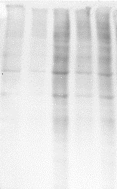

S3A
Control
6OHDA
6OHDA + ET
DAPI
MitoSOX
Merge
S3B
Propidium Iodide
S3C
Control | ET | 6OHDA | 6OHDA + ET | 6OHDA + ET + VHCL
100kDa
50kDa
37kDa
25kDa
42kDa
S3D
Tau
β-actin

Slide 7
Supplementary figure 3: ET ameliorates oxidative stress and global protein carbonylation in SH-SY5Y cells. (A) Fluorescence cytochemistry live-cell imaging for mROS. DAPI (blue) stains for nucleus whereas MitoSOX (red) stains for mROS. (B) Propidium iodide assay to quantify cell death in the treatment groups. Higher MFI readings would denote a greater number of non-viable cells present and vice versa. (C) Immunoblot of the different treatment groups. β-actin was used as the housekeeping protein for normalization. (D) Flow cytometry analysis to quantify relative tau protein expression among the treatment groups, as compared to control. (B-D) Data are represented as mean ± SD (n=3). Data were analyzed by One-Way ANOVA with Bonferroni’s multiple comparison post-hoc test. * p ≤ 0.05. ** p ≤ 0.01. *** p ≤ 0.001. **** p ≤ 0.0001.

Slide 8
Supplementary table 1: Primer sequences used for RT-qPCR
Supplementary Table S1. Primers used for RT-qPCR.
S/N | Primers (Homo Sapiens) | Sequences (5’ to 3’)
1 | GAPDH | Forward: GCAAATTCCATGGCACCGT Reverse: GCCCCACTTGATTTTGGAGG
2 | ACTB | Forward: AGATGAGATTGGCATGGCTTTA Reverse: GGACTTCCTGTAACAACGCATC
3 | OCT4 | Forward: CCTGAAGCAGAAGAGGATCACC Reverse: AAAGCGGCAGATGGTCGTTTGG
4 | NANOG | Forward: CTCCAACATCCTGAACCTCAGC Reverse: CGTCACACCATTGCTATTCTTCG
5 | MAP2 | Forward: AGGCTGTAGCAGTCCTGAAAGG Reverse: CTTCCTCCACTGTGACAGTCTG
6 | NeuN | Forward: TACGCAGCCTACAGATACGCTC Reverse: TGGTTCCAATGCTGTAGGTCGC
7 | NeuroD1 | Forward: GGTGCCTTGCTATTCTAAGACGC Reverse: GCAAAGCGTCTGAACGAAGGAG
8 | BDNF | Forward: CATCCGAGGACAAGGTGGCTTG Reverse: GCCGAACTTTCTGGTCCTCATC
9 | FOXA2 | Forward: GGAACACCACTACGCCTTCAAC Reverse: AGTGCATCACCTGTTCGTAGGC
10 | DAT | Forward: CCTCAACGACACTTTTGGGACC Reverse: AGTAGAGCAGCACGATGACCAG

