Slide 1
Figure S1
*

Slide 2
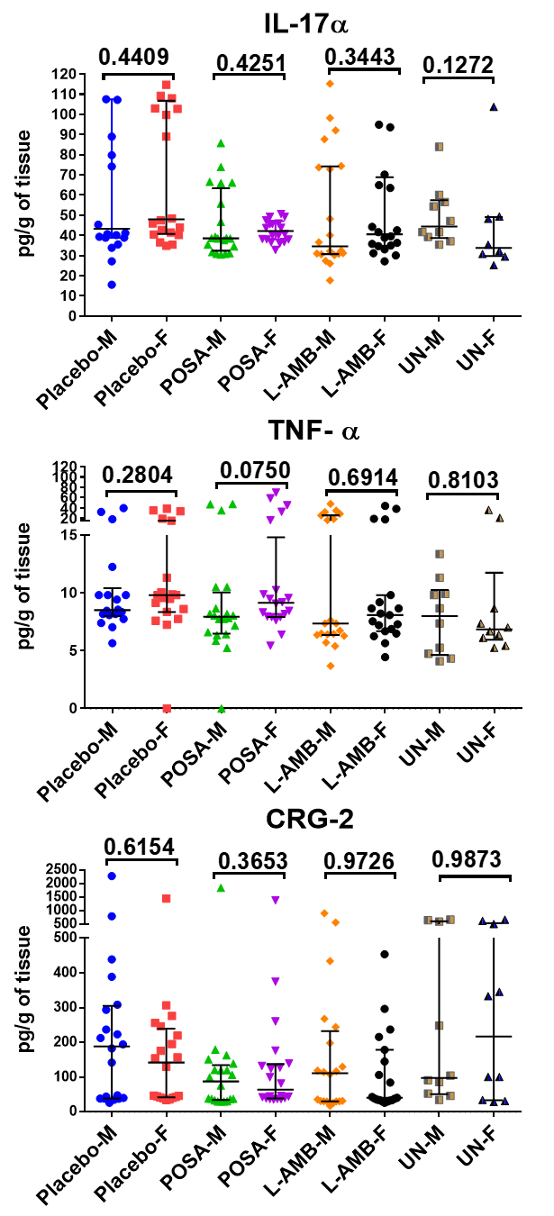
Figure S1
**
Figure S1. Cytokine analysis of lung homogenate from female or male DKA mice infected with R. delemar. Lung homogenate cytokines (n=20 from two independent experiments) were analyzed by luminex. *P = 0.01 for interferon-γ of POSA F vs. POSA M. **P = 0.02 for IL-12p70 of Placebo F vs. Placebo M.

Slide 3
Figure S2
*
*
*
*
*
*
*
*

Slide 4
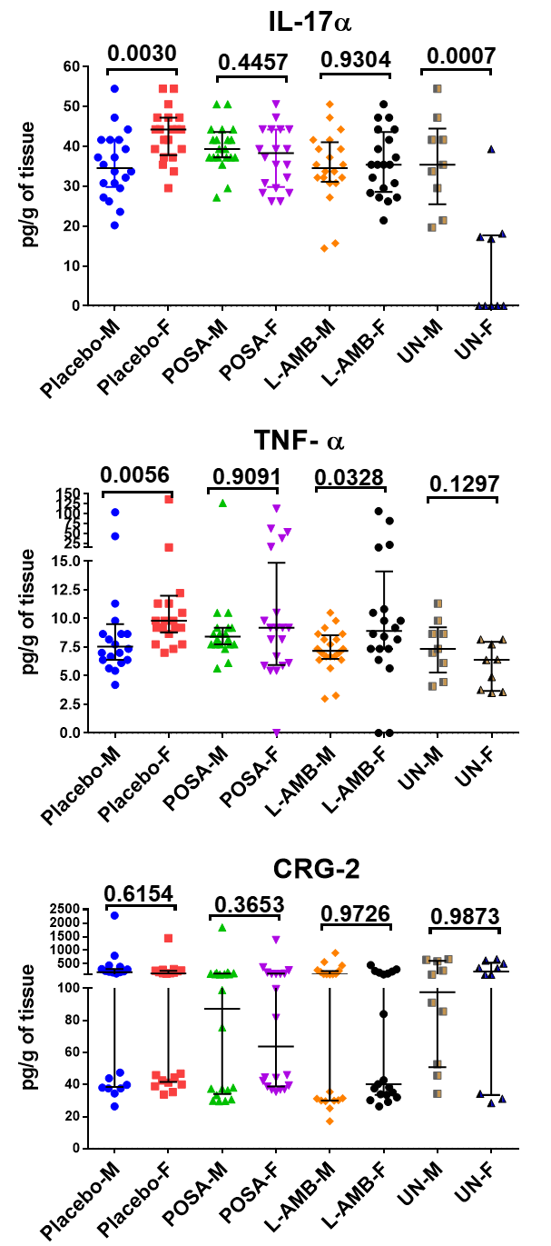
Figure S2
*
*
**
**
*
Figure S2. Cytokine analysis of lung homogenate from female or male DKA mice infected with M. circinelloides f. jenssenii. Lung homogenate cytokines (n=20 from two independent experiments) were analyzed by luminex. *P < 0.005 for IL-17α of Placebo F vs. Placebo M. **P < 0.05 for TNF-α of L-AMB F vs. L-AMB M.

Slide 5
Figure S3
*
**
***
¥
‡
**
**
Figure S3. Cytokine analysis of lung homogenate from female or male neutropenic mice infected with M. circinelloides f. jenssenii. Lung homogenates cytokines (n=23 from two independent experiments) were analyzed by luminex. *P < 0.05 for CCL2 of Placebo F vs. Placebo M. **P < 0.001 for IL-17α of POSA F vs. POSA M. ***P < 0.005 for CCL4 of L-AMB F vs. L-AMB M. ¥P < 0.05 for POSA F vs. POSA M. ‡P < 0.01 for POSA F vs. POSA M.

