Slide 1
The Rise and Fall of Cryptocurrencies
University of Oxford

Slide 2
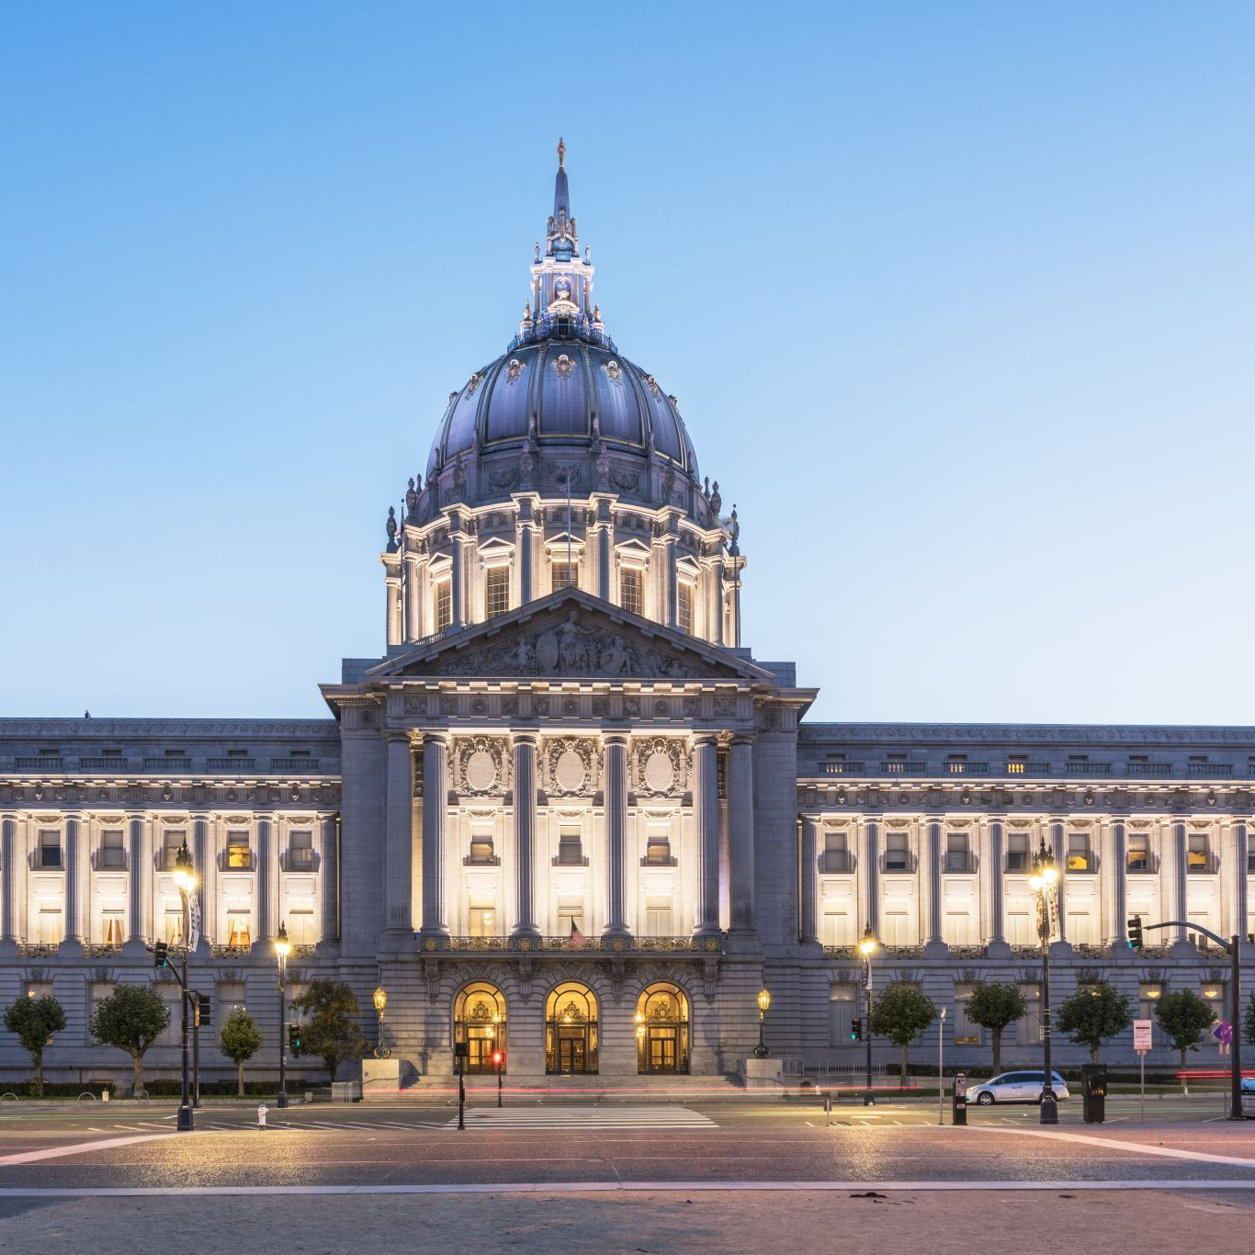
Cybersecurity Risks of the Metaverse
Dr Petar Radanliev
University of Oxford

Slide 3
The Rise and Fall of Cryptocurrencies: Defining the Economic and Social Values of Blockchain Technologies, assessing the Opportunities, and defining the Financial and Cybersecurity Risks of the Metaverse

Slide 4
Department of Engineering Science, University of Oxford, United Kingdom

Slide 5
Note
Funding: This work has been supported by the PETRAS National Centre of Excellence for IoT Systems Cybersecurity, which has been funded by the UK EPSRC ; the Software Sustainability Institute ; and by the Cisco Research Centre
Acknowledgements: Eternal gratitude to the Fulbright Commission

Slide 6
Abstract
This study contextualises the common queries of "why is crypto crashing?" and "why is crypto down?", the research transcends beyond the frequent market fluctuations to unravel how cryptocurrencies fundamentally work and the step-by-step process on how to create a cryptocurrency.

Slide 7
Introduction
This article delves deep into the complex world of digital currencies, clarifying the methods of investing in these volatile assets and the intricate mechanisms of crypto mining vs crypto staking
We explore the various platforms and methodologies for purchasing cryptocurrency, whilst also casting insights on the frequent price fluctuations observed in the market, analysing both the technical and external factors leading to periodic crashes and downturns
This study navigates the steps and challenges involved in creating a new cryptocurrency and guide readers through the intricacies of trading and maximising potential returns in the crypto market

Slide 8
Introduction
This article provides an up-to-date assessment of the current state of cryptocurrencies, examining both their values and associated risks within the realm of blockchain technology

Slide 9
Historical context
The report is influenced by points of view that existed before 2009 and have long been forgotten, such as the fear of Bitcoin legality, the ethics of decentralised control, and the ‘ethical impact of cryptocurrencies as morally beneficial, detrimental, and ambiguous’ and the ‘antisocial use for shadow banking and transactions in the ‘dark net’ and cryptocurrencies’ effect on inflation and deflation’
The article discusses the values and risks of a few selected Blockchain projects based on real-world value and their potential to contribute to the future of society
The main research areas reviewed in this study are included in Figure 1, which also helps visualise the main areas of interest in the year 2023 in the Metaverse concept

Slide 10
Historical overview of Blockchain technologies
The first whitepaper on Bitcoin emerged at the peak of the financial crisis in 2008 and it promoted the idea of a different economic system that is not dependent on a trusted third party
Bitcoin was considered a mechanism for criminals and drug dealers to bypass the legal banking system
Cryptocurrencies, or digital assets, serve as virtual currencies underpinned by cryptography, offering heightened security and privacy measures

Slide 11
Historical overview of Blockchain technologies
One argument for pursuing Cryptocurrencies as a solution to financial risk is ‘that the main indicators to improve financial development should enhance the process of bank lending and equity market development’ Second argument is that smart contracts and metaheuristic can help with securing the quality-of-service and even help with the ‘cost-efficient scheduling of medical-data processing’ , which seems of crucial importance for the medical systems in the UK – after the Covid shock to the National Health Service

Slide 12
Brief History of Cryptocurrencies
Cryptocurrencies are digital assets, or more precisely, a set of digital currencies that emerged with the release of Bitcoin in
Cryptocurrencies are traded as digital ‘tokens’ or ‘coins’ on a distributed and decentralised ledger
Bitcoin leads on market capitalisation, but other cryptos are trying to break into the market by providing different and improved services to Bitcoin
Some of the other cryptos - also known as ‘altcoins’, i.e., all cryptocurrencies other than Bitcoin – are used to create a decentralised financial system, e.g., Ethereum, with the ability to handle more transactions, e.g., Dogecoin, or just use different consensus algorithms, e.g., Cardano

Slide 13
Brief History of Cryptocurrencies
Cryptocurrencies remain highly volatile, and without central control, a single statement by Elon Musk has been sufficient to trigger a spike in search trends and attract significant interest in news media

Slide 14
Research questions and structure
To assess the potential of blockchain technology as a catalyst for innovation in future iterations of the internet and Web3 and to determine whether it represents a cutting-edge technology or an outdated concept in the context of financial invention
To comprehensively analyse and evaluate the risks associated with cryptocurrencies, including but not limited to market volatility, security vulnerabilities, regulatory challenges, and potential illicit activities, to understand the risk landscape within financial innovation better

Slide 15
Research questions and structure
Investigating and identifying the intrinsic values derived from cryptocurrencies, considering their potential impact on financial systems, economic growth, financial inclusion, transaction efficiency, and transparency, thus contributing to understanding their value proposition within financial innovation
Conduct a thorough analysis of different blockchain projects and their underlying technologies to identify critical factors that contribute to their long-term viability and survival in the dynamic landscape of financial innovation, thereby providing insights into the sustainability of blockchain projects

Slide 16
Research questions and structure
To explore and identify blockchain projects that have the potential to further the development and advancement of already developed countries' financial systems, addressing specific areas such as efficiency, security, transparency, financial inclusion, and regulatory compliance, thus providing valuable insights into the role of blockchain in enhancing financial innovation in advanced economies

Slide 17
Research questions and structure
To examine and identify blockchain projects that can foster development and progress in developing countries, taking into consideration their unique challenges and needs, including financial inclusion, access to capital, remittances, land registries, supply chain management, and government services, thereby contributing to the understanding of how blockchain can drive financial innovation in developing economies
To critically evaluate the feasibility and implications of regulating cryptocurrencies and blockchain projects, including both national and international regulatory frameworks, to assess the potential benefits, challenges, and trade-offs associated with effective regulation in the context of financial innovation

Slide 18
Crypto regulations
Given that the US has already started crafting new regulations on cryptocurrencies and after the markets collapsed in 2022, the European Union also started catching up with rules the UK recently started initial consultation plans to regulate cryptocurrencies
However, the proposed regulation suggests that cryptocurrencies should be overseen by the Financial Conduct Authority , and not all crypto is just a simple cryptocurrency
The consultation also suggests that all UK-based cryptocurrency firms should have anti-money laundering and KYC processes

Slide 19
Structure and novelty of the research study
This study offers a multifaceted exploration of blockchain technologies, investigating their economic, social, and wider implications within the Metaverse
The research highlights key themes from blockchain's impact across sectors to the fintech revolution
The novelty of the research is further underscored by its interdisciplinary approach, merging the fundamental principles of fintech investment strategies, blockchain, and the metaverse

Slide 20
Methodology
In this article, we present a robust research methodology, employing a combination of the case study method, survey review, and literature review to delve into the dynamic realm of financial innovation and its social implications
Drawing inspiration from established and time-tested guidelines such as Eisenhardt's 'Building Theories from Case Study Research' , Yin's recommendations on case study research, design, and methods , and the principles of Grounded theory , and the Grounded theory – Figure 4, provides a visual representation of the structured methodology, delineating areas of interest and focus
Our research methodology is thoughtfully divided into a dual emphasis on economic and social values

Slide 21
Data sources
The primary data collection included 20 case study interviews and three workshops
The secondary data collection included new and emerging forms of data that present new records of value in IoT-based intelligent contracts, including open data – ; spatiotemporal data; high-dimensional data; time-stamped data; real-time data and big data
To analyse NEFD, the data collection strategy in this article applied stratified sampling and random sampling for comparative analysis of collected NEFD

Slide 22
Contextualising this study with the existing body of literature
This section is focused on contextualisation of the findings and the novelty of the work in this study
This section compares the differences and similarities, including the findings and novelty, of this work, with eight articles closely related to the research area investigated in this study
This study started with a systematic review of existing studies that used data records obtained from the Web of Science Core Collection , focusing on the broad landscape of blockchain's impact across sectors, highlighting key themes from economic benefits to the fintech revolution

Slide 23
Contextualising this study with the existing body of literature
Within this body of literature, this study on "The Rise and Fall of Cryptocurrencies" offers a complex and interesting exploration, delving deep into the intricacies of cryptocurrency and the broader implications in the metaverse
This in-depth focus on the metaverse and its associated challenges underlines the novelty of this work, positioning it as a pivotal piece that bridges gaps in the current literature and offers fresh insights into the evolving digital realm
This new investigation into the metaverse, an area not deeply touched upon by Fang et al., accentuates the novelty and contemporaneity of this research, presenting a holistic view that complements and augments existing literature

Slide 24
Academic literature review
Decentralised finance is at present isolated to Blockchain projects
Still, most of the existing financial instruments can be transferred into an alternative economic infrastructure with the help of Blockchain Oracles
Decentralised finance transactions can be cleaner than traditional finance and support ‘local climate adaptation planning and implementation’
This was a natural progression, given that digital finance and renewable energy consumption have already been studied for economic growth and technological progress, with evidence from China
Blockchain and digital finance have also been the subject of other studies

Slide 25
Academic literature review
It has been almost half a decade since the Blockchain was suggested as the new ‘secure, decentralised, trusted cyber infrastructure solution for future energy systems'

Slide 26
Case Study Review: Case studies of existing Blockchain solutions

Slide 27
Blockchain 3.0 and Web 3.0
Blockchain technology, initially introduced through Bitcoin, combines cryptography with distributed computing, both of which have existed for several decades
Blockchain 1.0 represents a distributed secure database where a network of computers collaborates and shares data
Blockchain relies on a distributed consensus algorithm, requiring agreement among different nodes before any alteration can be made
The evolution of blockchain technology has led to Blockchain 2.0, exemplified by Ethereum, which introduces the capability to execute any computer code on the system, essentially creating a distributed virtual computer

Slide 28
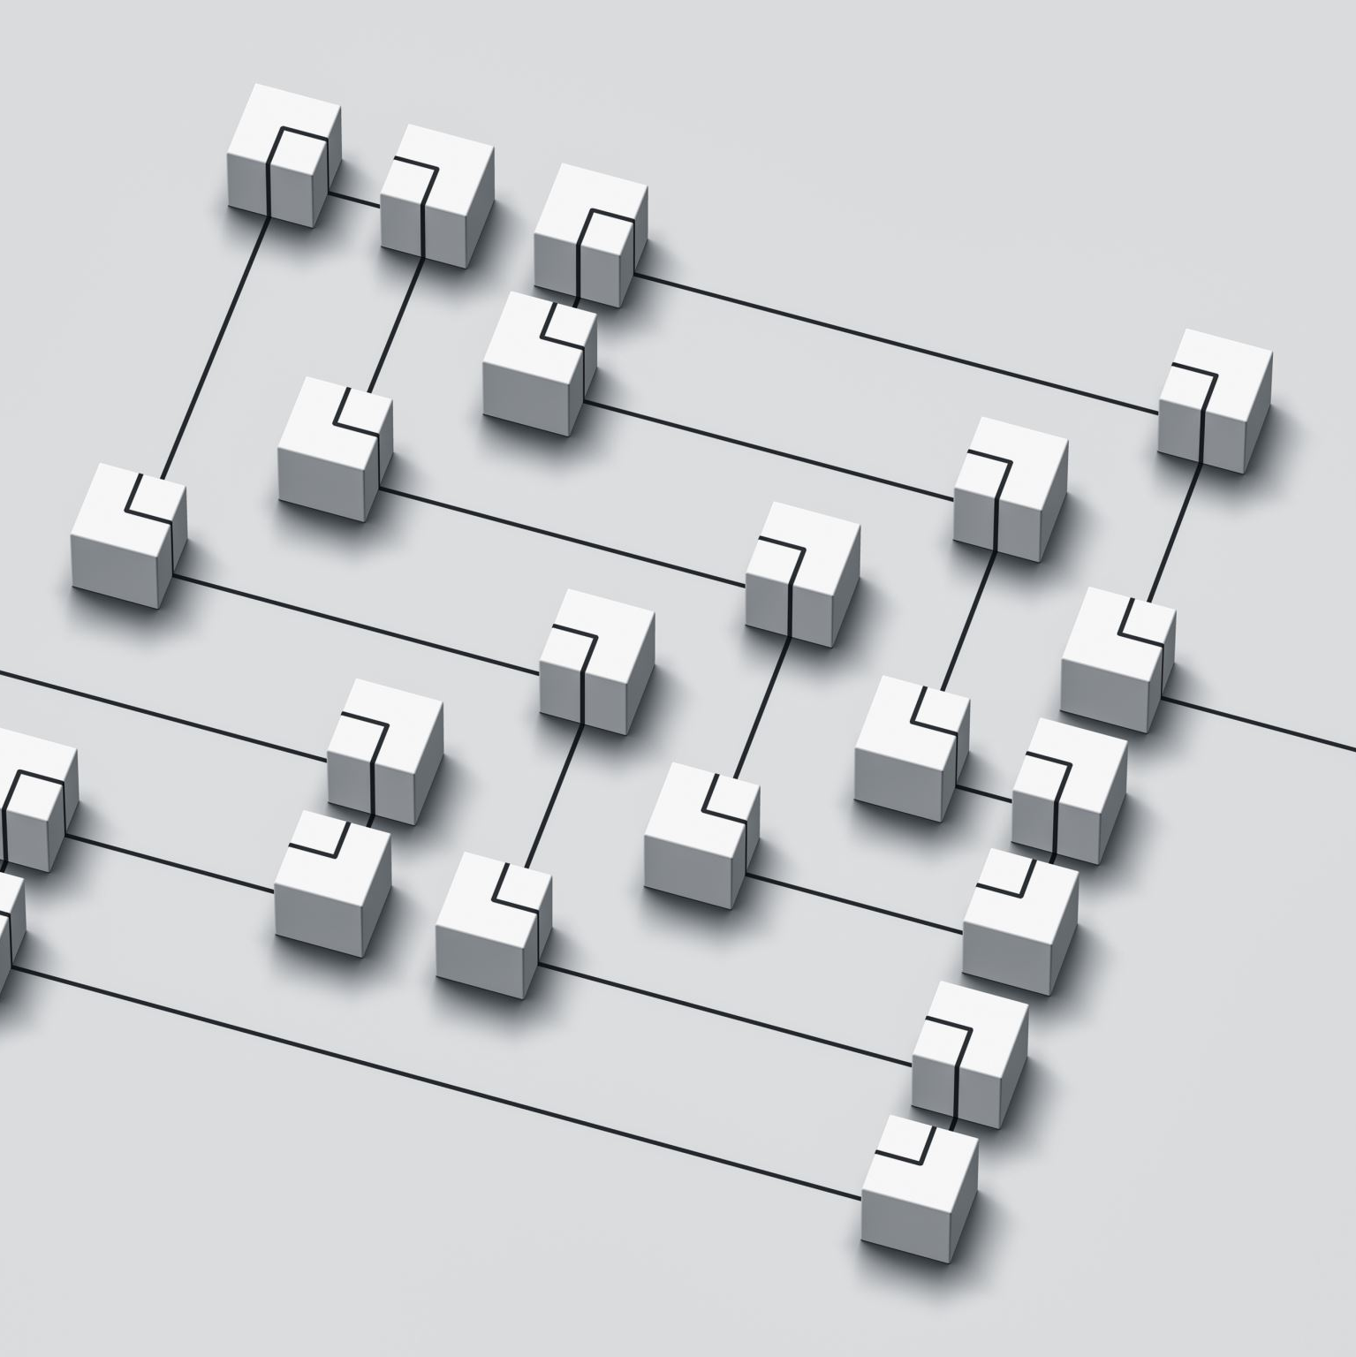
Blockchain 3.0 and Web 3.0
Blockchain 2.0 enables the creation of decentralised ledgers for asset registries, encompassing physical and intangible assets, such as property, currencies, patents, votes, identity, and healthcare data
Blockchain 3.0 introduces "The Distributed Cloud," a pivotal infrastructure supporting the development of the next generation of the internet, also known as Web 3.0 or the decentralised web

Slide 29
IoT-based Blockchain solutions
The Internet-of-Things is already used in Blockchain 3.0 as an open-source distributed ledger and has presented many unique alternatives for storing transactions with a potential for higher scalability over Blockchain 1.0 based distributed ledgers
IOTA is keeping its name but evolving into a new blockchain called Crysalis
Although the idea of IoT-based crypto is undeniably valuable, further research is required to determine how IoT technologies would resolve the main problem of Blockchain 1.0, namely the
IOTA and other Blockchain 3.0 technologies are run by IoT systems, which can be considered reliable if the devices are secure

Slide 30
IoT-based Blockchain solutions
Security and reliability are necessary for technological adoption in critical infrastructure, and NHS supply chains can benefit from improved security that comes with Blockchain technologies
The potential for Blockchain adoption is there but is currently bottlenecked by scalability

Slide 31
IoT for healthcare
The increased adoption of IoT in health services seems inevitable – because IoT offers increased efficiency at a reduced amount of time spent, which appears to be what the NHS needs, but the value of the low cost of IoT comes at risk
This IoT automation in national critical infrastructure must come with increased security to the traditional legacy IT systems – , and there are various solutions for improved cybersecurity

Slide 32
IoT for healthcare
One of the leading crypto projects that could benefit NHS is the ‘VeChain’ project, which resolves many of the existing supply chain issues – , especially the software supply chain, which has many areas of current work, including the Software Bill of Materials – , the Vulnerability Exploitability Exchange – , and many other research efforts
Since IoT Blockchains operate as decentralised systems, with cryptographic hashing of data in blocks, this will resolve whether the data belongs to patients, the NHS, and the technology providers

Slide 33
Decentralised finance – DeFi
Decentralised finance is built upon automated protocols that offer financial services
DeFi solutions bring numerous advantages compared to traditional finance, including faster transaction speeds, improved transparency, interoperability, and immutability
In 2023, several significant DeFi protocols have emerged, such as Aave, Compound, Curve Finance, Synthetix, PancakeSwap, Kyber Network, Uniswap, and others
As DeFi continues to evolve, striking a balance between speed, compliance, and decentralisation becomes crucial for sustainable growth

Slide 34
Centralised exchanges
Centralised exchanges faced significant challenges in 2022, and without comprehensive regulatory oversight, they appear poised to repeat past mistakes
While surviving centralised exchanges like Binance, Coinbase, Kraken, and KuCoin, among others, claim to adhere to compliance standards, the absence of effective oversight is evident, with limited exceptions in the United States, Australia, and New Zealand
In Australia and New Zealand, certain major exchanges are subject to regulatory measures that encompass ATO and AML compliance, as well as KYC protocols

Slide 35
Layer 1s and 2s, Non-Fungible Tokens , and the Metaverses
Blockchains such as Bitcoin and Ethereum are called Layer 1 in decentralised terminology
Non-Fungible Tokens represent unique pieces of art, digital content, or media within the Metaverse
The Metaverse ecosystem encompasses a diverse range of blockchains, protocols, and tokens, providing unique opportunities for participation and engagement within virtual environments

Slide 36
Crypto Bridges and Oracles
Blockchain bridges enable the movement of assets from one Layer 1 to another Layer 1 or from Layer 1 to Layer 2 and the reverse
Some of the most famous bridges in 2023 include Hop Exchange, Orbiter, Rango Exchange, cBridge, xPollinate, AllBridge, and many others
While Bridges resolve interoperability issues across chains, Oracles enable cross-chain communication and intelligent contracts to execute on different Blockchains

Slide 37
Crypto Wallets
Cryptocurrency digital wallets can be classified into three main categories
The first category comprises safe storage tricky wallets, where cryptocurrencies are securely stored on a personal device
To summarise the information presented: Classifying cryptocurrency wallets into these categories provides users with various options to suit their preferences for security, accessibility, and management of their digital assets

Slide 38
Lessons to be learned from the past errors: the two Cases of FTX and Terra Luna
The first is to create standards and regulations for cryptocurrencies because as of today , we have 22,228 different cryptos and 534 crypto exchanges, with a market cap of $824,468,428,103 and 24h trade volume of $16,374,071
The second is to ban all use of cryptocurrencies, including ownership and trading, but this is unlikely to be effective because most crypto projects are run from outside of the UK, and some are decentralised
The third option is to create fully centralised Government run Blockchains, upon which open crypto projects and exchanges can be built
In contrast, in 11th place, we have DAI

Slide 39
Lessons to be learned from the past errors: the two Cases of FTX and Terra Luna
The main lesson we must learn from FTX is that without taking regulatory action, corporate malfunction and malfeasance cases will continue to dominate the cryptocurrency ecosystems

Slide 40
Survey of Crypto use cases
Borderless payments without any centralised entities acting as an intermediary
Decentralised finance for lending and borrowing, accessible to anyone and everyone that has an internet connection and knows how to use the specific blockchain–crypto project
Security and privacy of products as they move through different supply chains
Authenticity verification for products and services
Ensuring payments are processed somewhat in supply chains- with the use of smart contracts
Buying and owning digital assets, such as gaming and collectables, can be held as non-fungible tokens
Crypto transactions can be designed to help with privacy and anonymity, creating added value for users that prefer to keep their finances private

Slide 41
Survey of Crypto use cases
Crypto can be used for crowdfunding, where new funds can be raised by issuing initial coin offerings or token generation events
Creatives can use crypto to monetise their work
Charitable donations, crypto can be used as a fast and secure method for transferring wealth to people in need

Slide 42
Evolution and Uncertainties of the Internet: From Web1 to Web3
The internet has undergone significant transformations over the years, from the emergence of Web1 as the "information highway" to the interactive capabilities of Web
However, Web2 has raised concerns regarding privacy exploitation, paving the way for the anticipated arrival of Web3, which is expected to be built on blockchain technology
The blockchain's primary use case has already found its place in adopting blockchains within Web
This section explores the evolution of the Internet and the uncertainties surrounding the dominance of specific platforms and cryptocurrencies
The transition from Web1 to Web2 can be likened to the shift from AOL to Hotmail

Slide 43
Evolution and Uncertainties of the Internet: From Web1 to Web3
Similarly, Ethereum has emerged as the dominant force in the crypto world, particularly with the introduction of layer two projects like Optimism and Arbitrum

Slide 44
The Buterin's trilemma
This review article would not be complete without discussing the Buterin's trilemma and how that fundamentally captures the trade-offs between security, decentralisation, speed, and the attendant risks
One study suggested a solution called ‘The Blockchain Quadrilemma’ but also recognised that for basic Blockchain operations ‘, Algorand can often be the right choice’, but Ethereum is recommended for ‘more sophisticated computations’

Slide 45
The Buterin's trilemma
Another research study recommended ‘a dichotomy of algorithms between leader-based and voting-based consensus algorithms’ based on ‘tradeoffs … for a given distributed system’ It is worth mentioning that some experts recommend an ‘incentive-based role in the governance of DeFi as opposed to an enforcement-oriented role’ because we need to build new tools that enable new ‘policy options in a transnational environment hostile to formal state intervention’

Slide 46
Discussion
Crypto is still subject to many risks for investors and users
One of the main risks for investors is that the value is highly volatile and fluctuates significantly in short periods
This makes crypto price and value extremely difficult to predict, leading to significant losses when the value drops significantly
To explain this, in other words, the Blockchain is as secure as it has been described in the first paper written by Satoshi, but the new projects are bypassing the security requirements, often because there are no cybersecurity standards

Slide 47
The good
The SWIFT network is very slow compared to some of the crypto solutions, and the idea of tokenised USD does seem appealing to many users, specifically traders
Cryptocurrencies can also solve many of the banking problems in developing countries
The ability to make payments and transfer tokens pegged with the value of USD could provide solutions to much of the developed world still lacking essential banking services

Slide 48
The bad
Bitcoin emerged from the financial chaos in 2008, and it was presented as a solution to the centralised banking system and the high-risk practices of a few greedy financial firms that only care about profits
The cryptocurrencies only replaced one centralised set of intermediaries that are strictly regulated, with another set of centralised intermediaries that are not regulated
Despite the fall of FTX, crypto exchanges do not want to be controlled, and they are challenging to regulate, because they can be run from anywhere in the world

Slide 49
The bad
One of the reasons for this is that consumers prefer the safety and service of third parties looking after their money and rarely prefer keeping their savings in a cold wallet that can be lost, damaged, or hacked, along with all the money saved
The shift from decentralised money to centralised exchanges just shows that people prefer the convenience of a third party looking after their money
Instead, cryptocurrencies trade purely on sentiment, and most of the price spikes are created by influencers and social media
If this trend continues, we can argue that even decentralised cryptocurrencies are just decentralised Ponzi schemes and rely on a supply of new buyers to buy new tokens at higher prices

Slide 50
The ugly
Currently, the crypto market is not connected to traditional markets and is relatively small
The main concern is that if the crypto market is regulated in a way that it would get supercharged and it’s allowed to create the connections between regulated finance and the crypto system, then crypto problems can become much bigger problems
In this article, we focused on the crypto ecosystem and the risk and values of the technology for society and the economy – from a perspective of improved wealth of a nation

Slide 51
The ugly
Cryptocurrency trading and gambling have also been associated with mental health problems, including depression and anxiety, with the main findings confirming a direct similarity between the demographic and personality characteristics of cryptocurrency traders and gamblers

Slide 52
Conclusion
In conclusion, this article has comprehensively examined the current state of cryptocurrencies and blockchains, aiming to enhance coherence, structure, and comprehensibility within the domain
We have shed light on the values and risks associated with these digital assets by presenting an up-to-date snapshot of the crypto landscape in 2023 and tracing its historical development from Satoshi's pioneering work
Moreover, we have endeavoured to clarify the distinctions between cryptocurrencies and blockchain technologies, addressing pertinent research questions regarding the innovative nature of blockchain, the significant risks posed by cryptocurrencies, and the potential societal and economic benefits of pursuing these technologies

Slide 53
Conclusion
Our comprehensive discussion on the value derived from blockchain projects underscores their significance while re-evaluating key risks, including a personal reflection from the author on the potential risks
Much of the recent hype around crypto is around the lack of regulations, and when regulations are applied, the promise of getting rich from crypto will certainly start to weaken
With regulations, crypto projects will have to start making checks on who their customers are, and this argument for regulations killing the crypto is especially strong for cryptocurrencies that are created with no actual use case and based purely on the promise of making a great deal of money for early investors

Slide 54
Final comments
A final comment on investing in crypto, despite the remarkable returns some investors have benefited from, the crypto market has not matured yet, and the market – including the technology – is still evolving
In addition, we still cannot use Bitcoin or any other Crypto to buy coffee in Costa or Starbucks, we cannot buy food in Tesco, and transactions come at a cost, while using fiat doesn’t cost
On the other hand, the claim that Bitcoin is used for crime and money laundry has been contradicted by blockchain analysis company Chainalysis, which reported that only a very small percentage of known cryptocurrency transactions conducted in 2021 were involved in illicit activities

Slide 55
Abbreviations
Bitcoin – the first decentralised blockchain
Terra Luna – collapsed crypto project
FTX – collapsed crypto exchange
Solana – crypto project that got affected by the FTX collapse
Ethereum, Cardano, Dogecoin, Litecoin, Algorand, NEAR – crypto projects that remained popular with investors in the 2021 bull run
IOTA, NEO, EOS – crypto projects that were popular in the previous bull runs, and are still present in the crypto market in
NEFD - new and emerging forms of data
CBDCs - Central Bank Digital Currencies
Tornado Cash DAO – crypto mixer that has been prohibited for use by the USA
UST Algorithmic Stablecoin – collapsed stablecoin

Slide 56
Abbreviations
USDT, USDC, DAI, BUSD, USDP, USDD, TUSD - Stablecoins still in existence in
NHS – National health Service
Uniswap / SushiSwap – decentralised exchanges
NFTs - non-fungible tokens
ICO - initial coin offerings
TGEs - token generation events
ChatGPT – AI based chat designed to replace the Google search engine
M-Pesa - SIM card payment from a mobile phone
We Chat Pay - a QR Code payment
KYC – know your customer

Slide 57
References
M
Moore et al., “Scudo: A Proposal for Resolving Software Supply Chain Insecurities in Vehicles The second in a series of whitepapers on emerging and critical issues in automotive cybersecurity”

