Slide 1
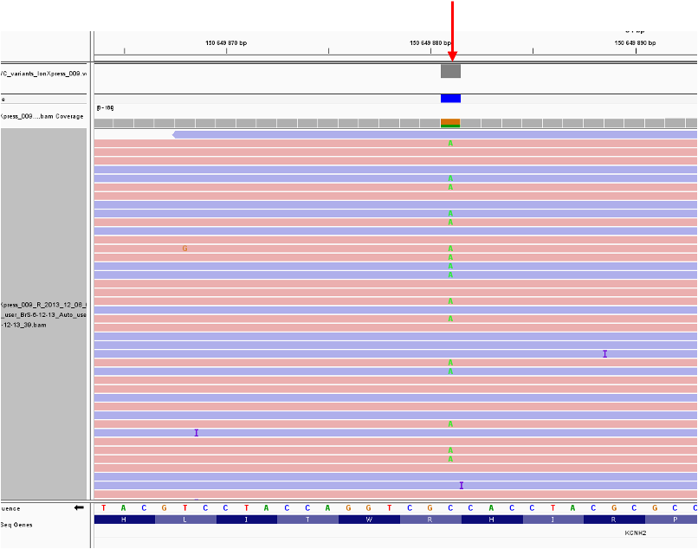
Supplemental materials
Figure S1. Heterozygous variant NM_000238:c.1189C>T (p.R397C) in the KCNH2 gene found by NGS sequencing based on IonTorrent PGM platform (ThermoFisher Scientific, USA). Visualization is in the Integrative Genome Viewer. Heterozygous variant is marked by arrow.

