Slide 1
Figure File PPT

Slide 2
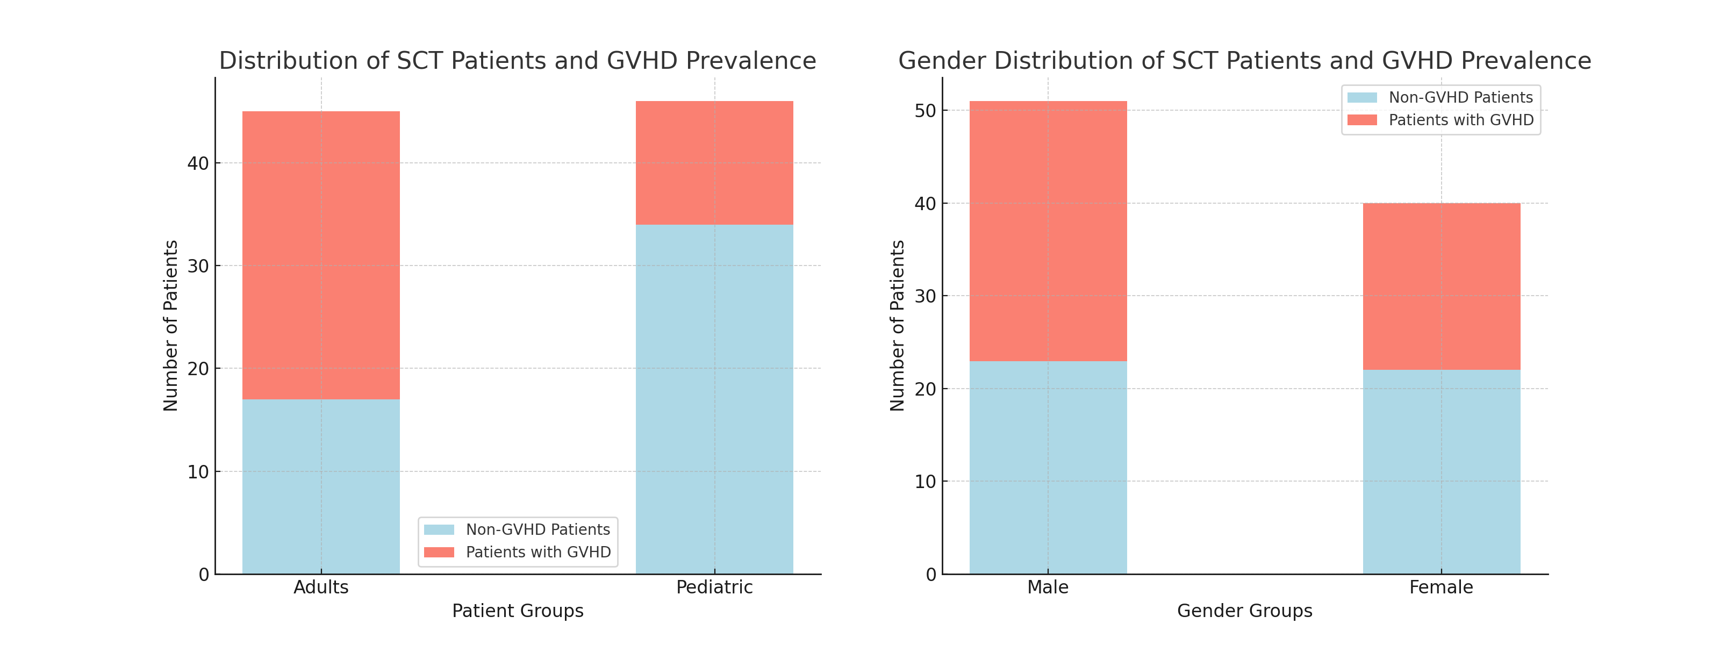
Figure 1:Distribution of SCT Patients and GVHD Prevalence This figure presents the distribution of stem cell transplant (SCT) patients and the prevalence of graft-versus-host disease (GVHD) across different patient groups and gender groups. The left panel shows the breakdown between adult and pediatric patients, indicating that 45 adults and 46 pediatric patients received SCTs. Among these, 28 adults (62.2%) and 12 pediatric patients (26.1%) developed GVHD. The right panel displays the gender distribution, with 51 male and 40 female patients. Among them, 28 males (55%) and 18 females (45%) developed GVHD. Light blue bars represent non-GVHD patients, while salmon bars represent patients who developed GVHD.
28/45
62.2%
12/46
26%
28/51
55%
18/40
45%
17/45
37.8%
34/46
74%
23/51
45%
22/40
55%

Slide 3
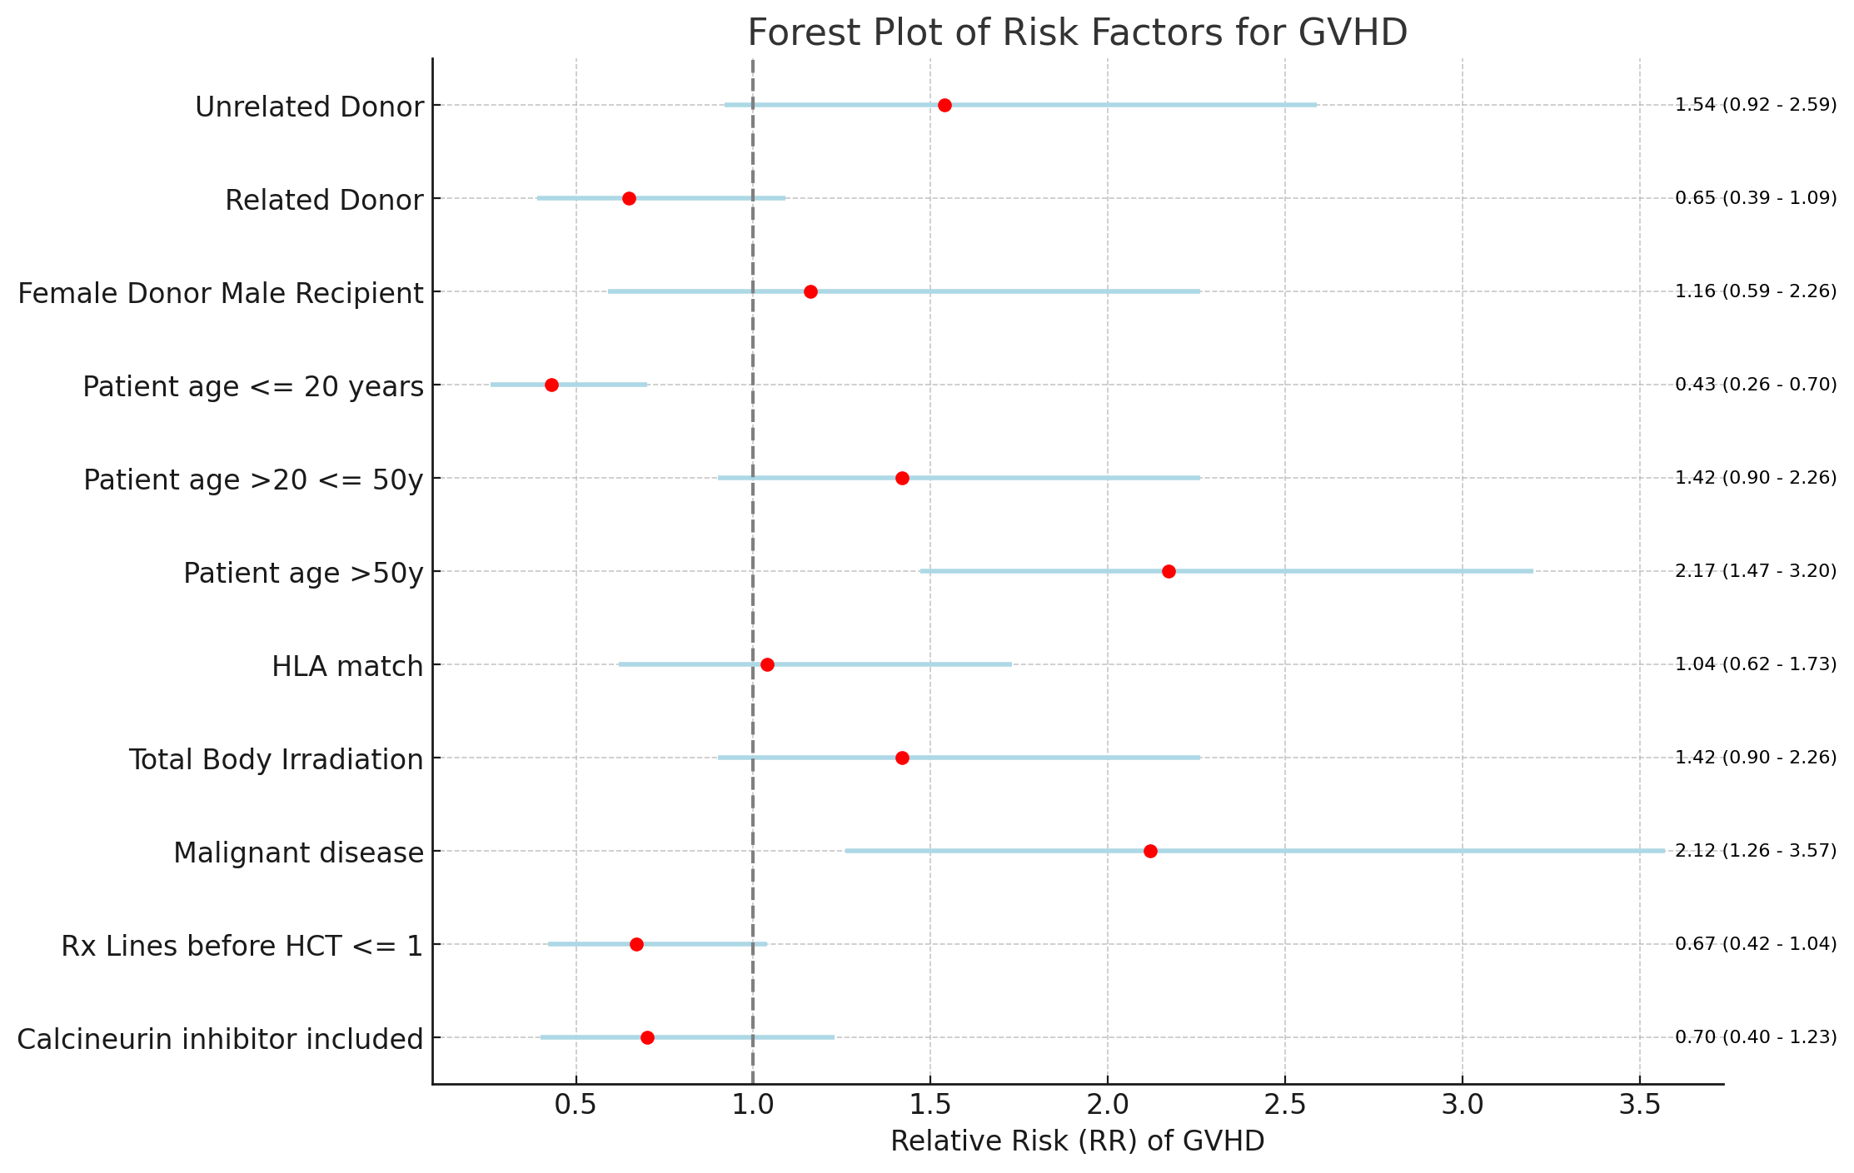
Figure 2: Forest Plot of Risk Factors for GVHD This forest plot illustrates the relative risk (RR) of graft-versus-host disease (GVHD) associated with various risk factors in dialysis patients. The red dots represent the point estimates of the RR, while the light blue lines indicate the 95% confidence intervals (CIs) for each estimate. A vertical dashed line at RR = 1.0 represents the null hypothesis (no increased risk). The values to the right of the plot provide the RR and 95% CI for each risk factor, indicating the range within which the true RR is likely to fall.

Slide 4
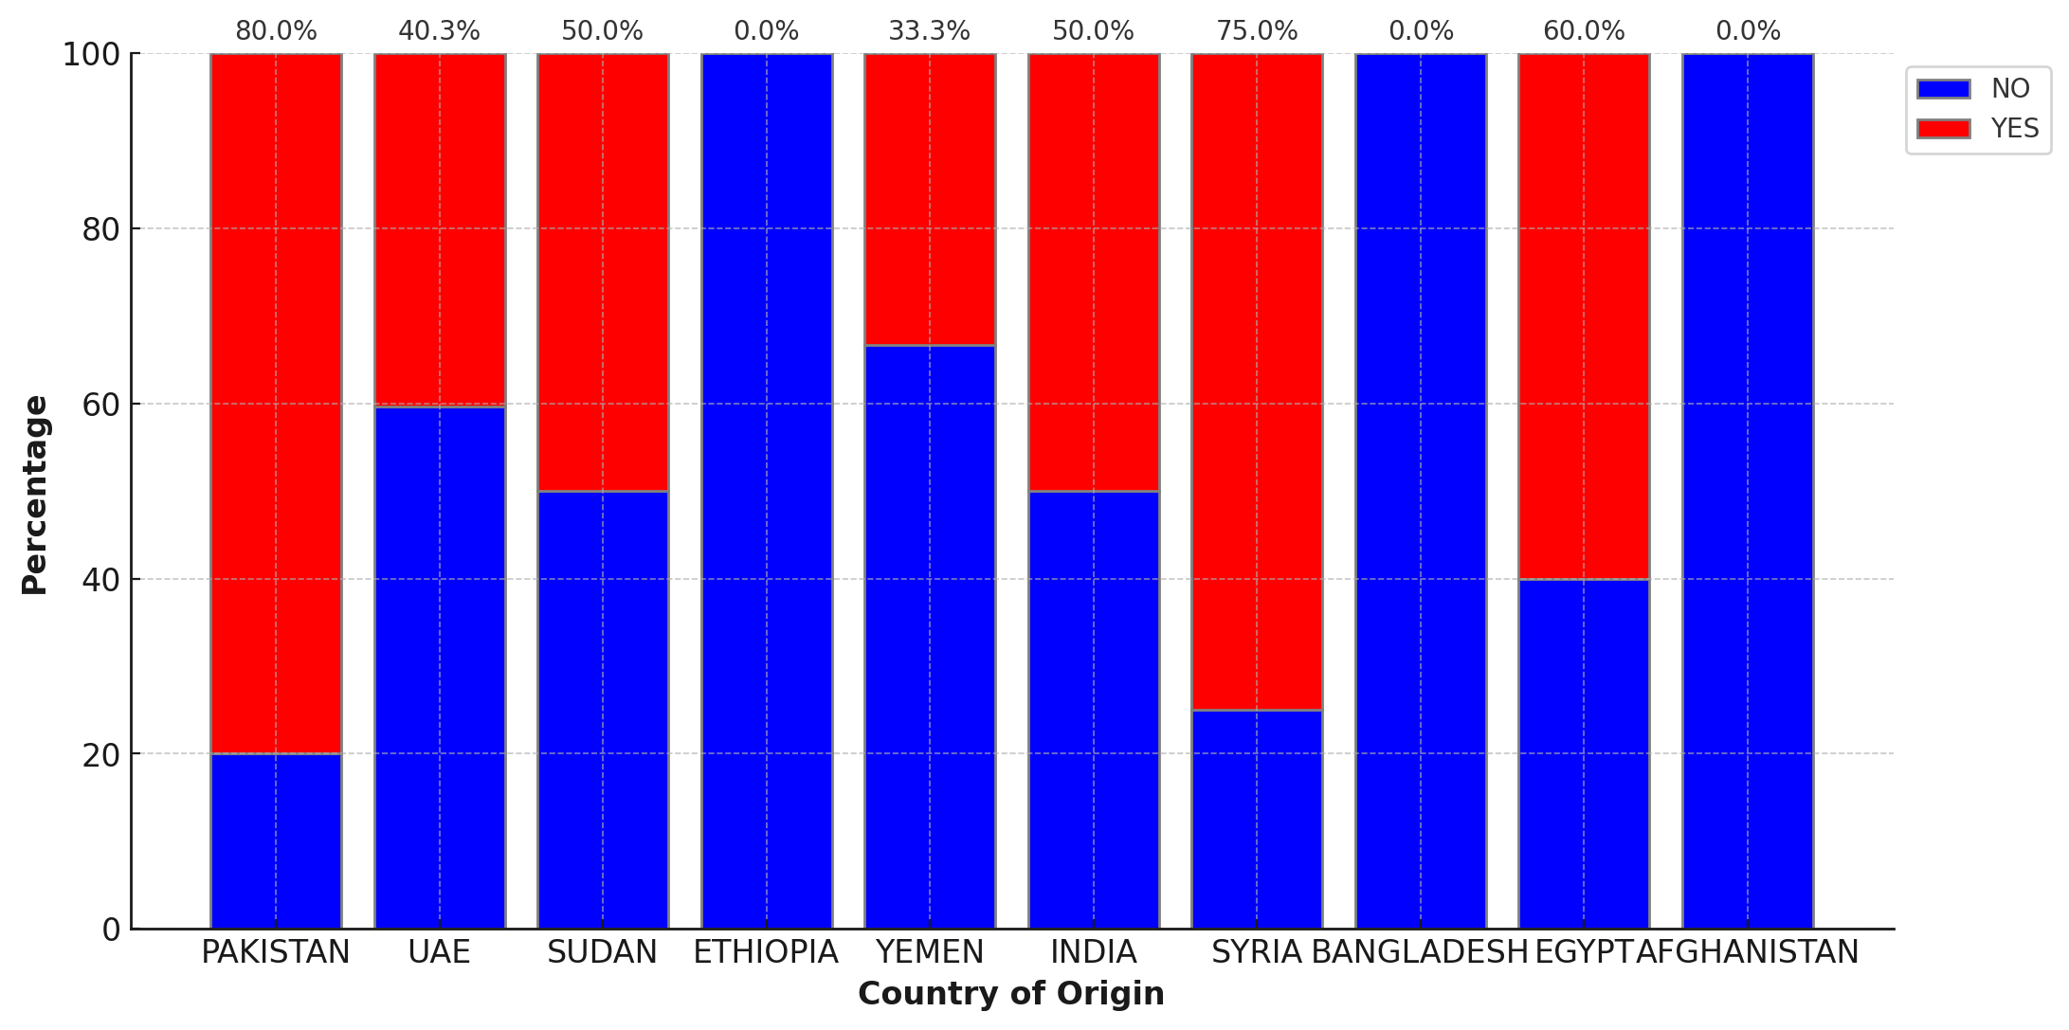
Figure 3 Percentage Distribution of GVHD by Country of Origin for Stem Cell Transplant Patients This bar graph displays the percentage distribution of graft-versus-host disease (GVHD) among stem cell transplant patients who are residents of the United Arab Emirates, categorized by their country of origin. The blue bars represent the percentage of patients without GVHD, while the red bars indicate the percentage of patients with GVHD. This visualization helps to compare the prevalence of GVHD across different countries of origin within the patient population.
4
25
2
1
2
3
3
1
37
2
1
2
2
1
2
2
1

Slide 5
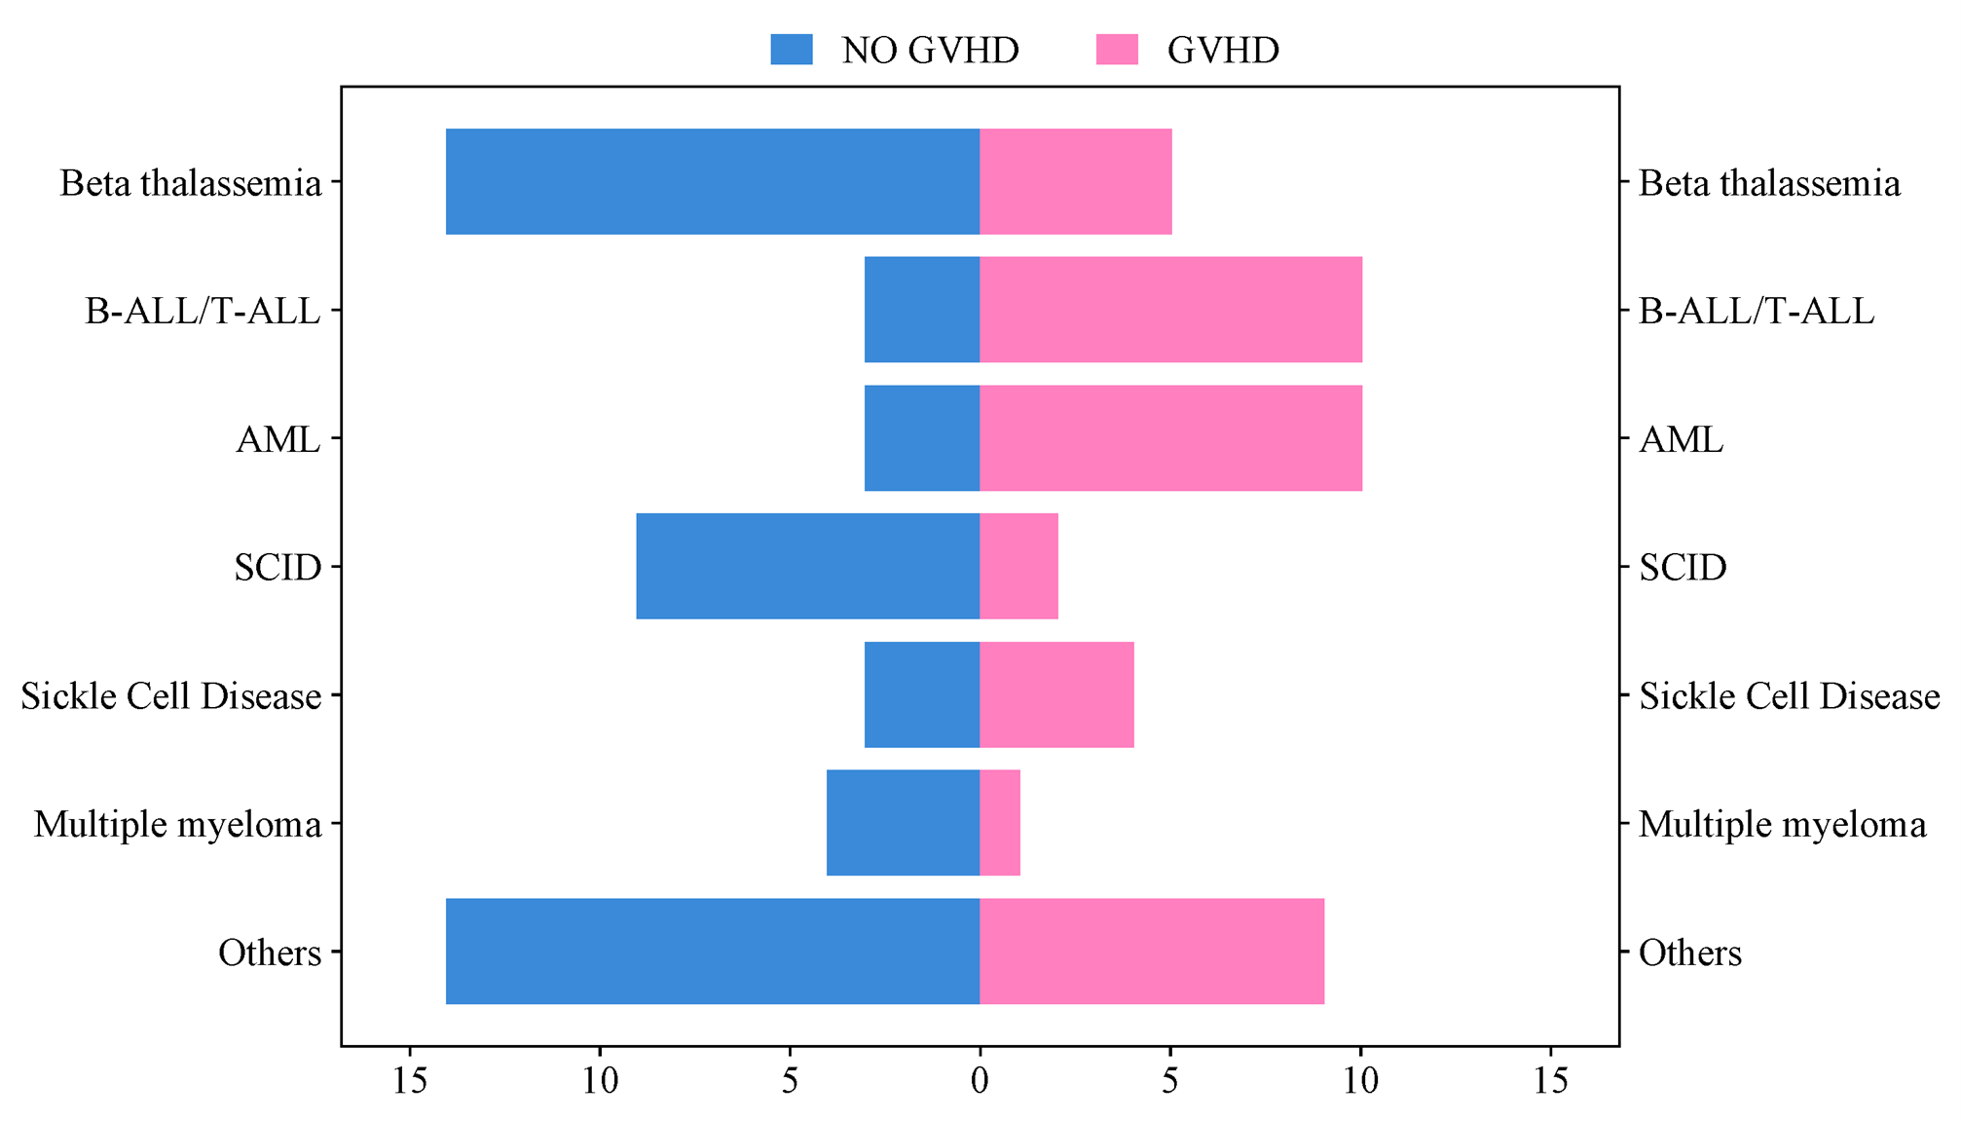
Figure 4 Distribution of GVHD and Non-GVHD Patients Based on Hematological Disease This horizontal bar graph illustrates the distribution of graft-versus-host disease (GVHD) and non-GVHD patients categorized by different hematological diseases. The blue bars represent the number of patients without GVHD, while the pink bars indicate the number of patients with GVHD. The diseases included are Beta Thalassemia, B-ALL/T-ALL, AML, SCID, Sickle Cell Disease, Multiple Myeloma, and others. This visualization provides insight into the prevalence of GVHD among patients with various hematological conditions.

Slide 6
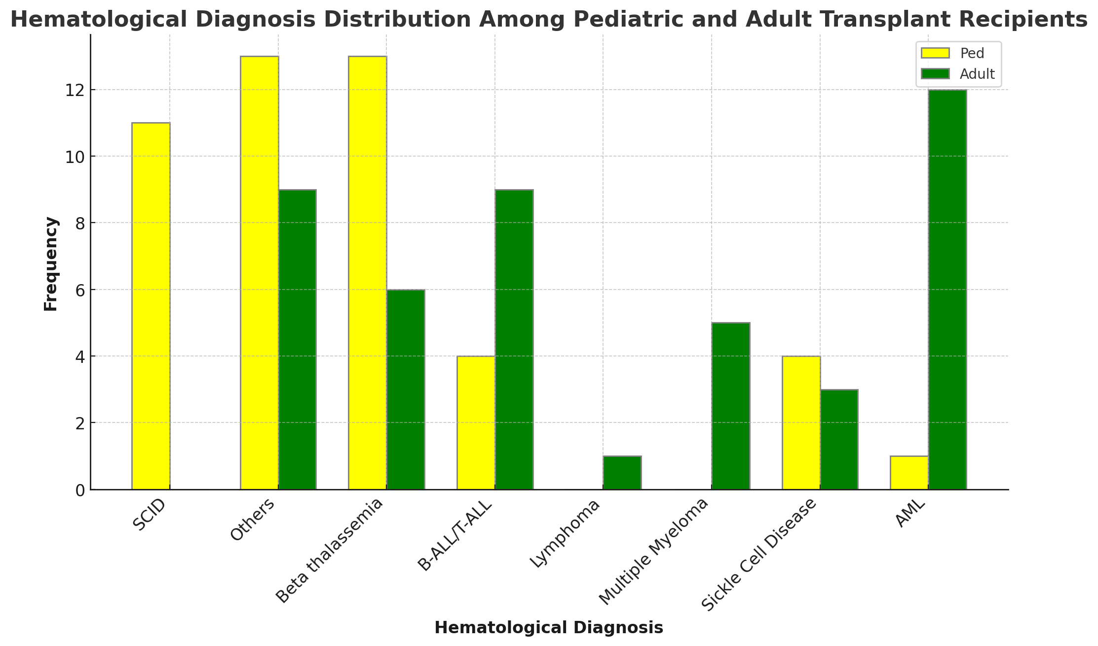
Figure 5 Hematological Diagnosis Distribution Among Pediatric and Adult Transplant Recipients . This bar graph presents the frequency distribution of various hematological diagnoses among pediatric (yellow bars) and adult (green bars) transplant recipients. The diagnoses include SCID, Others, Beta Thalassemia, B-ALL/T-ALL, Lymphoma, Multiple Myeloma, Sickle Cell Disease, and AML. This visualization highlights the differing prevalence of these diagnoses between pediatric and adult patient groups.

