Slide 1
Superconductor (NbTi)
MagA
MagB
SU
S N
S N

Slide 2
3
SU
FS1＞0
FS2＞0
S N
S N
Interact
interact
interact
interact
1
SU
SU
2
4
SU
S N
S N
S N
S N
△E=0
△E=0
△E＞0

Slide 3
❶
S
U
S ❸ N
S ❷ N
△E＞0
❶
S
U
S ❸ N
S ❷ N
△E=0

Slide 4
FS1＞0
SU
S N
S N
△W>0
SU
S N
S N
△E=0
SU
S N
S N
△E=0
FS2＞0
SU
S N
S N
△E=0
△E＞0

Slide 5
SU
S N
△W＞0
S N
S N
SU
△E=0
S N
SU
S N
△E=0
S N
S N
SU
△E＜0
S N
△E=0

Slide 6
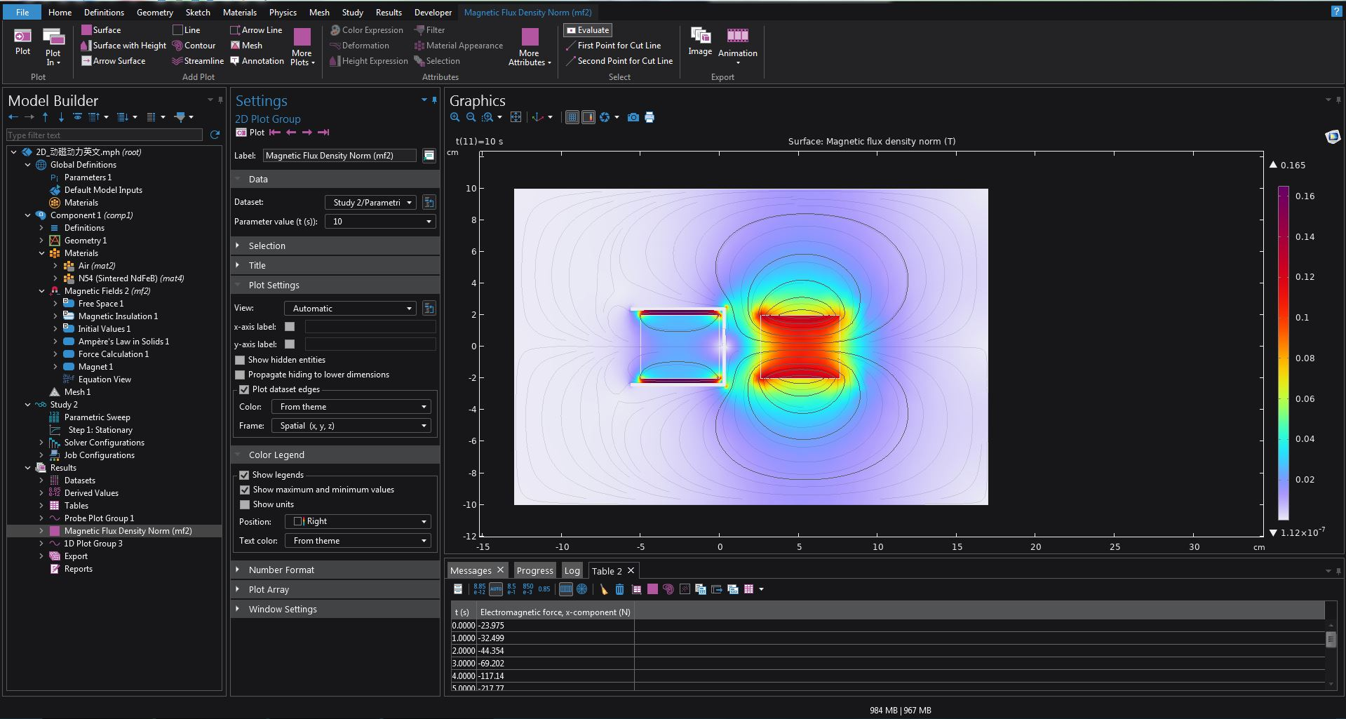
Physics fields and superconducting material parameters used in the simulation

Slide 7
Complete model
Simulation video
Without the fixed magnet
Simulation video
Without the moving magnet
Simulation video
Moving magnet replaced with ferromagnet
Simulation video

Slide 8
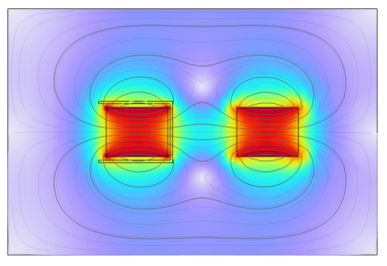
Electromagnetic distribution at each time point in the complete model
0s
5s
6-8s
9s
11s
13s

Slide 9
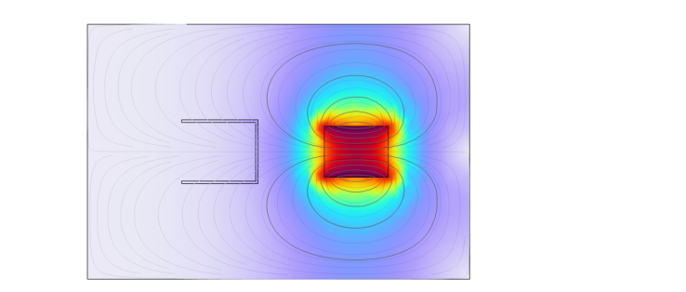
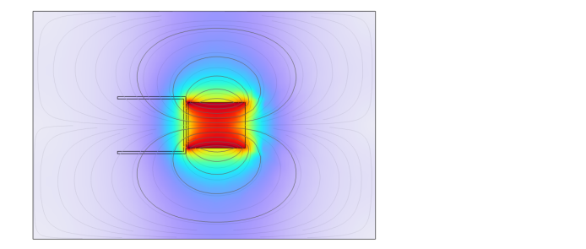
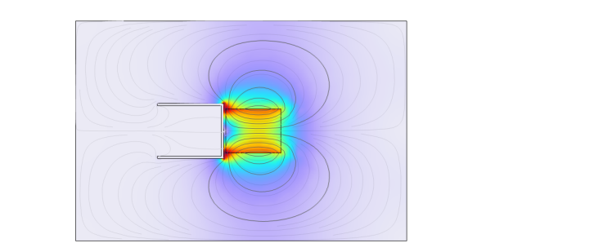
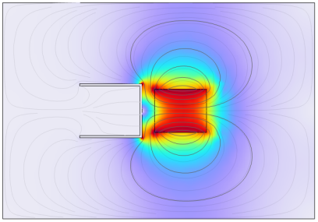
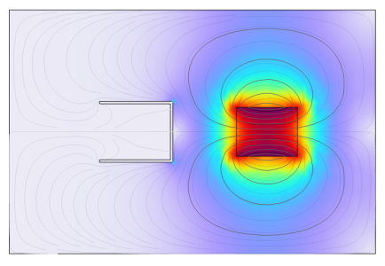
Electromagnetic distribution at each time point for the moving magnet only
0s
5s
6-8s
9s
11s
13s

Slide 10
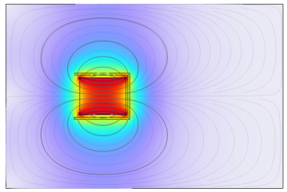
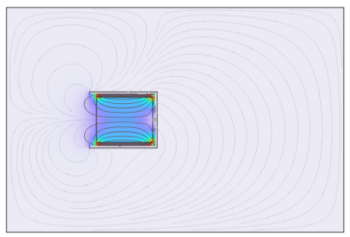
Electromagnetic distribution at each time point for the fixed magnet only
0-5s
6-13s

Slide 11
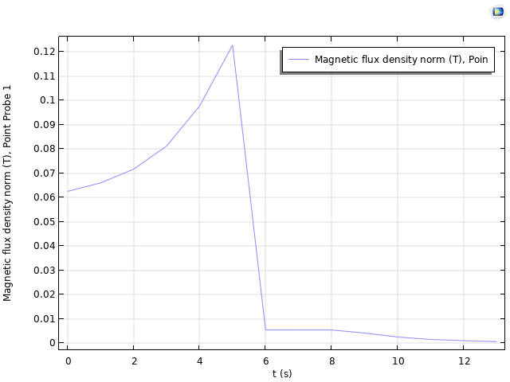
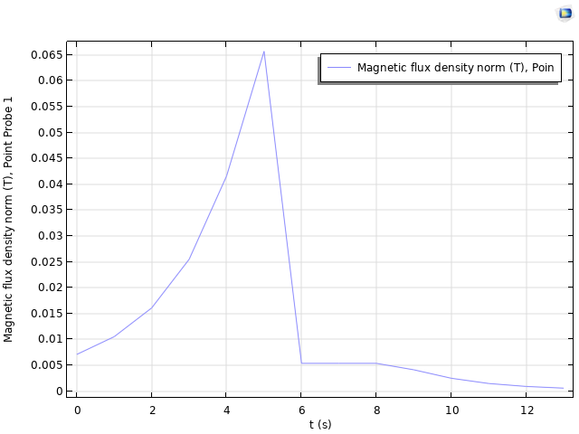
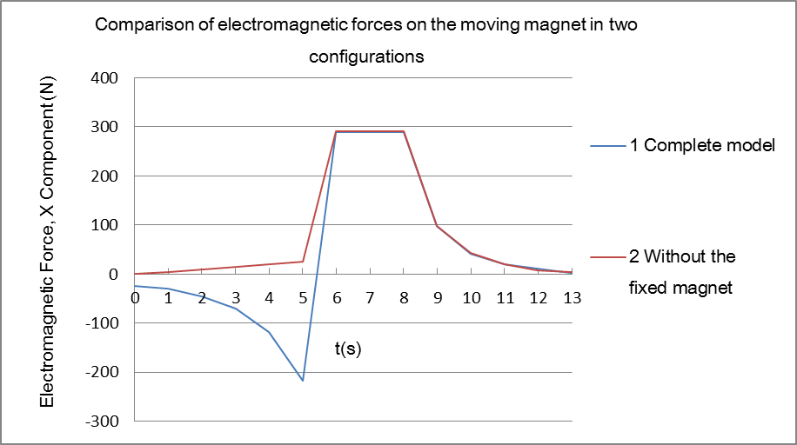
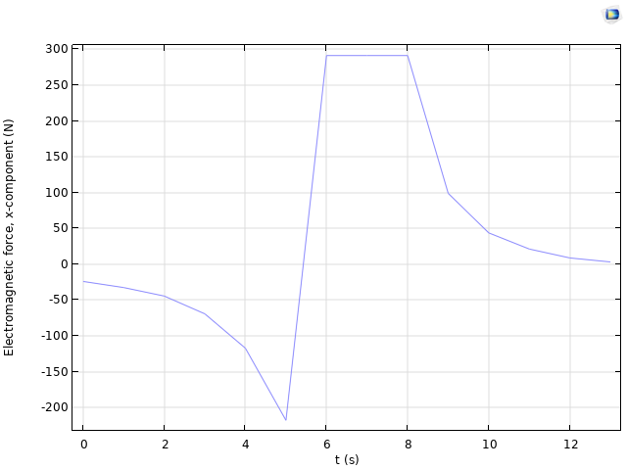
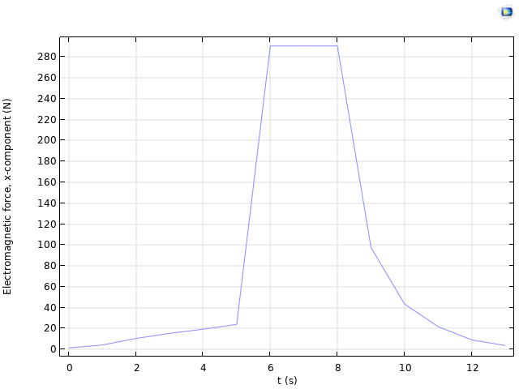
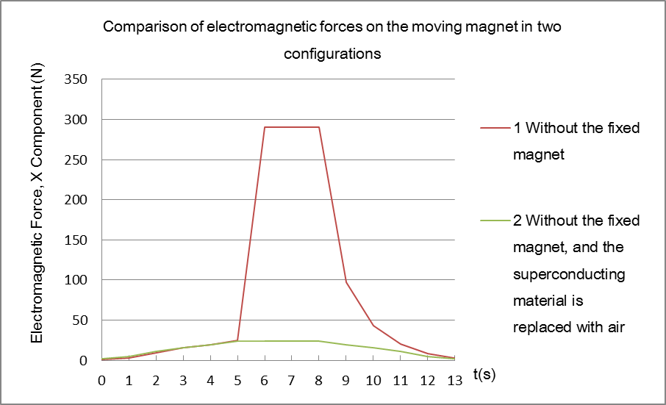
Magnetic flux density magnitude at Point 1 in the complete model
Magnetic flux density magnitude at Point 1 for the moving magnet only
Comparison of Magnetic Flux Density Magnitude at Point 1 in Two Configurations
Electromagnetic force in the X direction on the moving magnet in the complete model
Electromagnetic force in the X direction on the moving magnet for the moving magnet only
Comparison of Electromagnetic Force in the X Direction on the Moving Magnet in Two Configurations

Slide 12
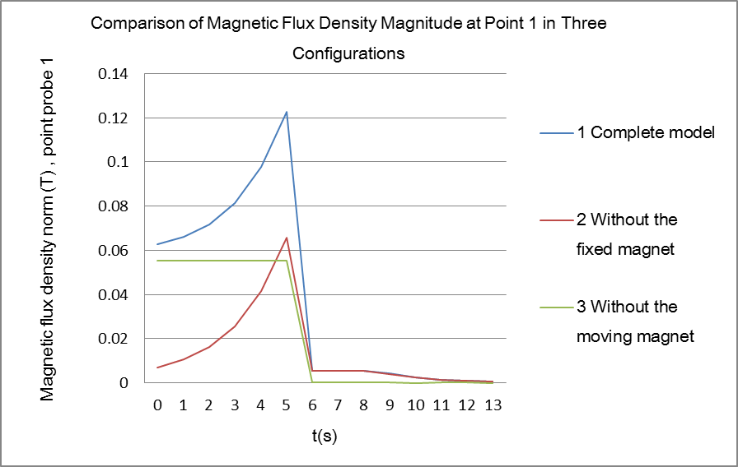
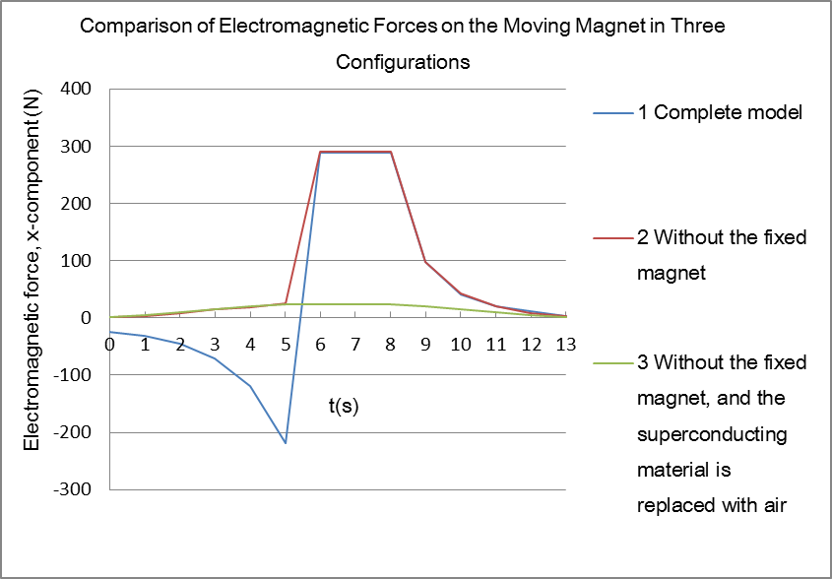
Comparison of Magnetic Flux Density Magnitude at Point 1 in Three Configurations
Comparison of Electromagnetic Force in the X Direction on the Moving Magnet in Three Configurations

Slide 13
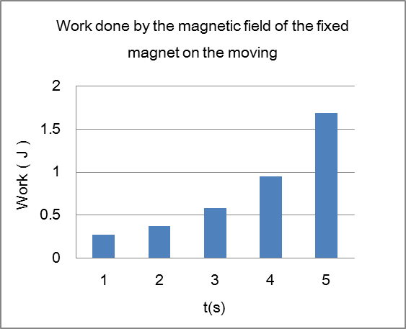
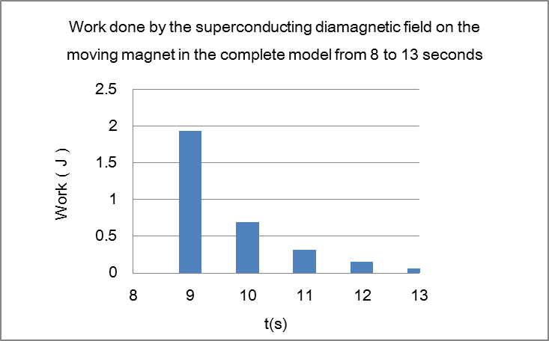
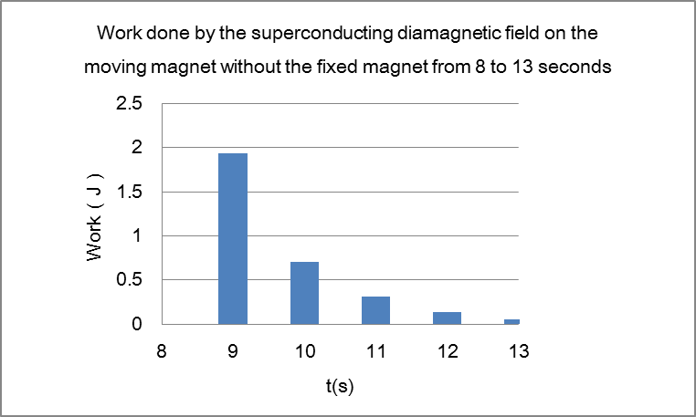
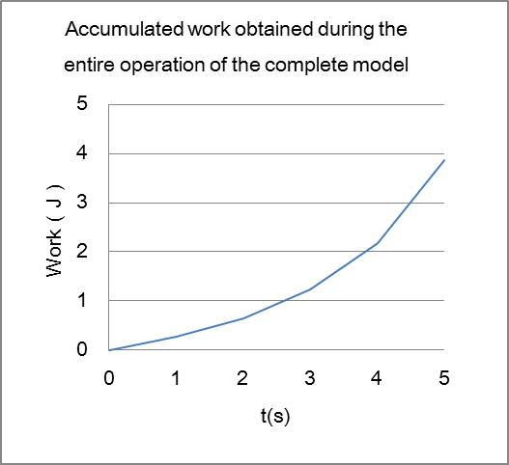
Work Done by the Fixed Magnet's Magnetic Field on the Moving Magnet in the Complete Model from 0 to 5 Seconds
Work Done by the Superconducting Diamagnetic Field on the Moving Magnet in the Complete Model from 8 to 13 Seconds
Work Done by the Superconducting Diamagnetic Field on the Moving Magnet without the Fixed Magnet from 8 to 13 Seconds
Accumulated Work Obtained Throughout the Entire Operation of the Complete Model

